Slide 1
Strategic Technologies for Europe Platform (STEP)
Overview of Cohesion Policy
amendment adoptions per Member State
https://strategic-technologies.europa.eu

Slide 2
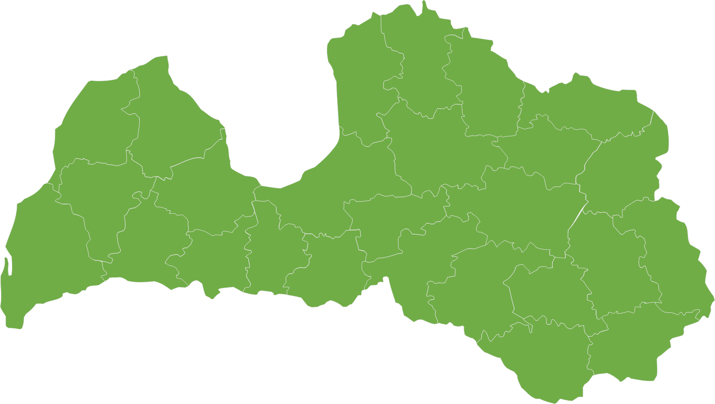
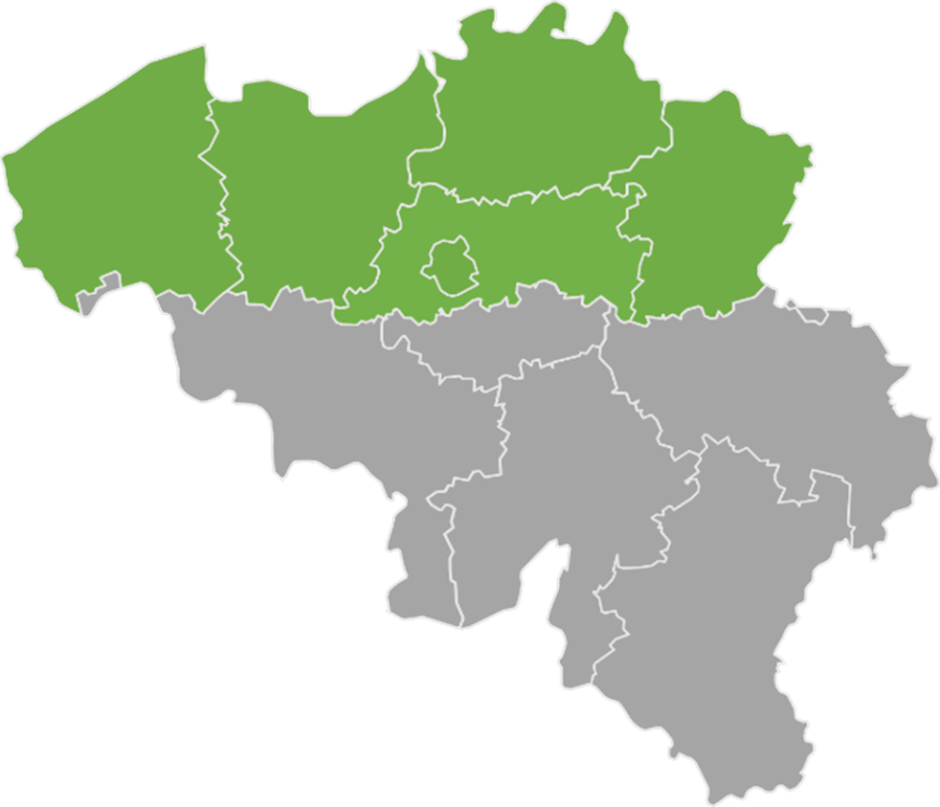
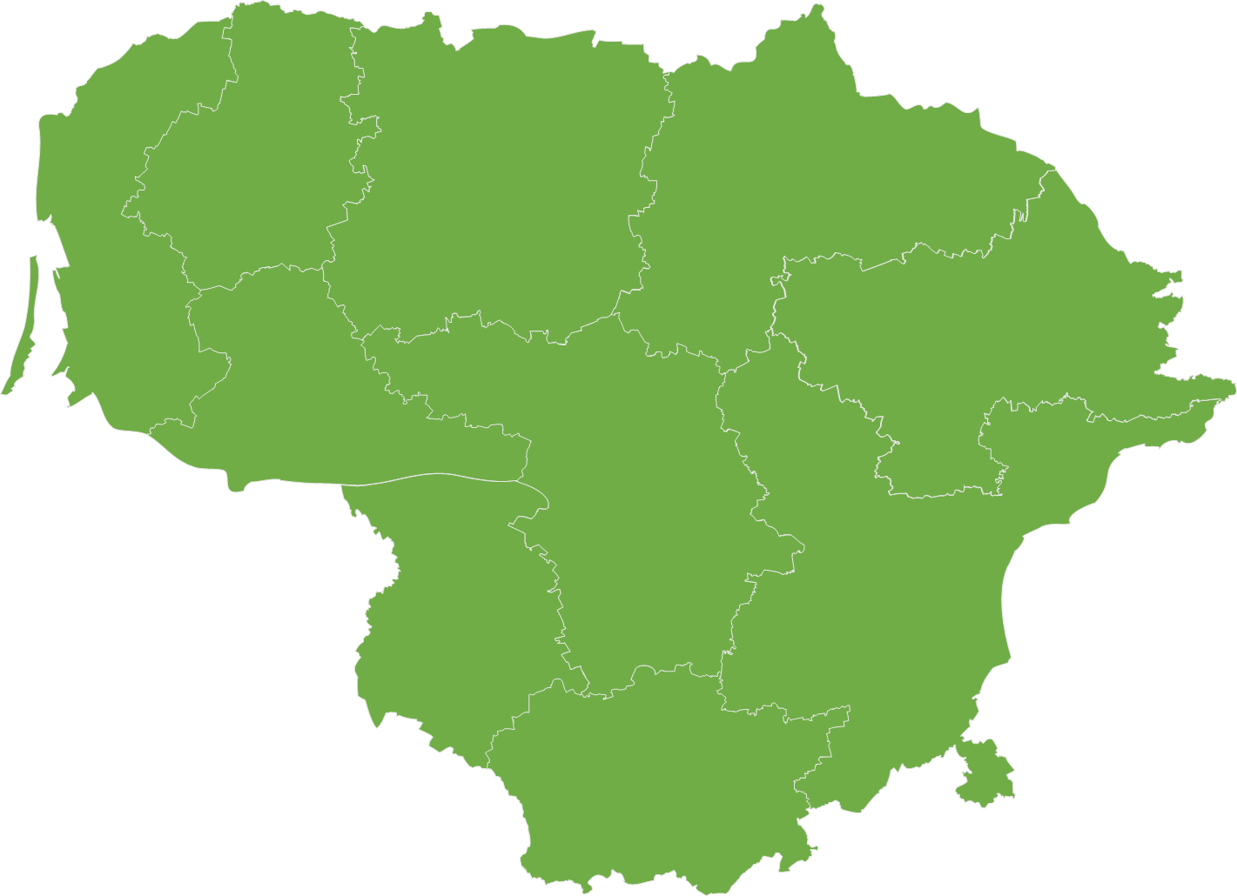
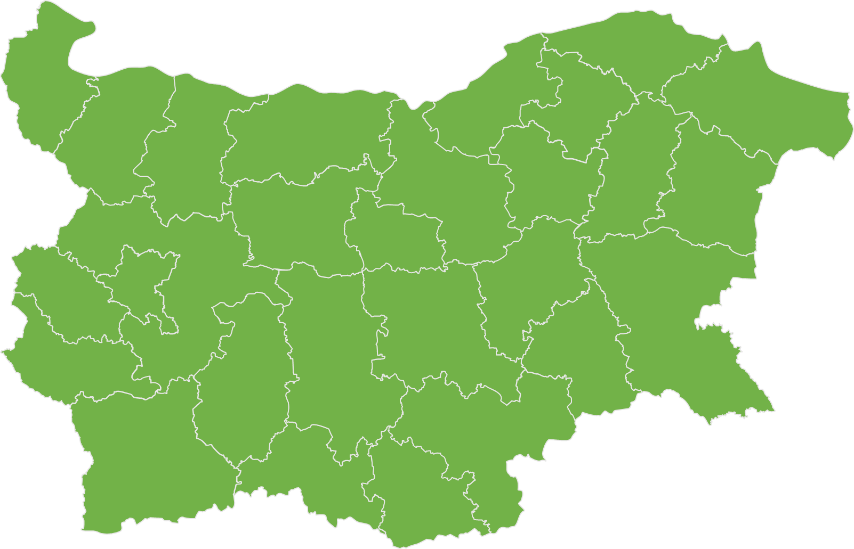
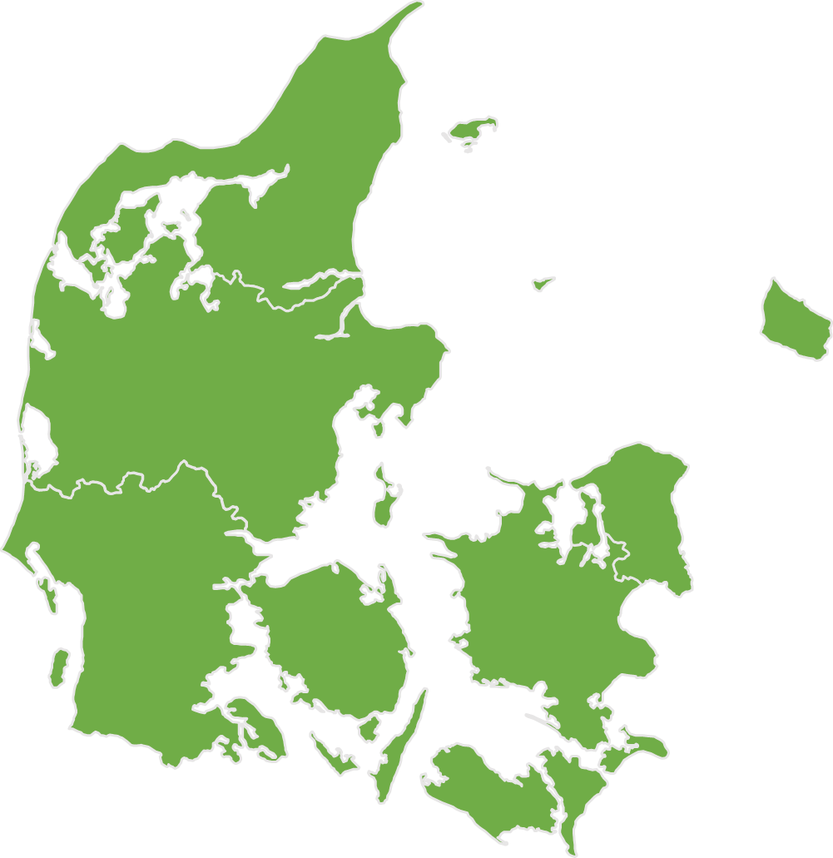
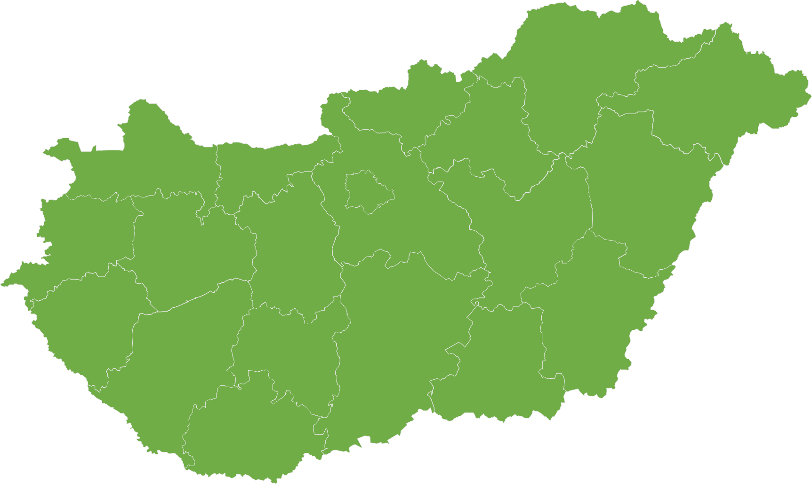
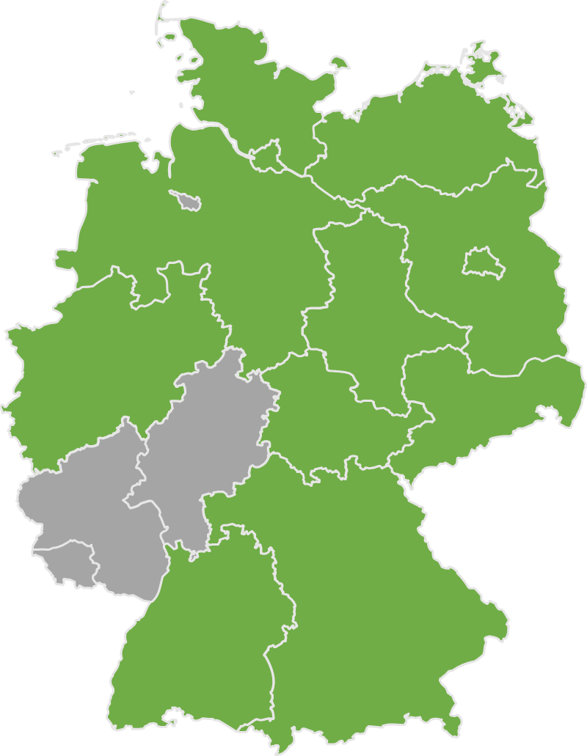
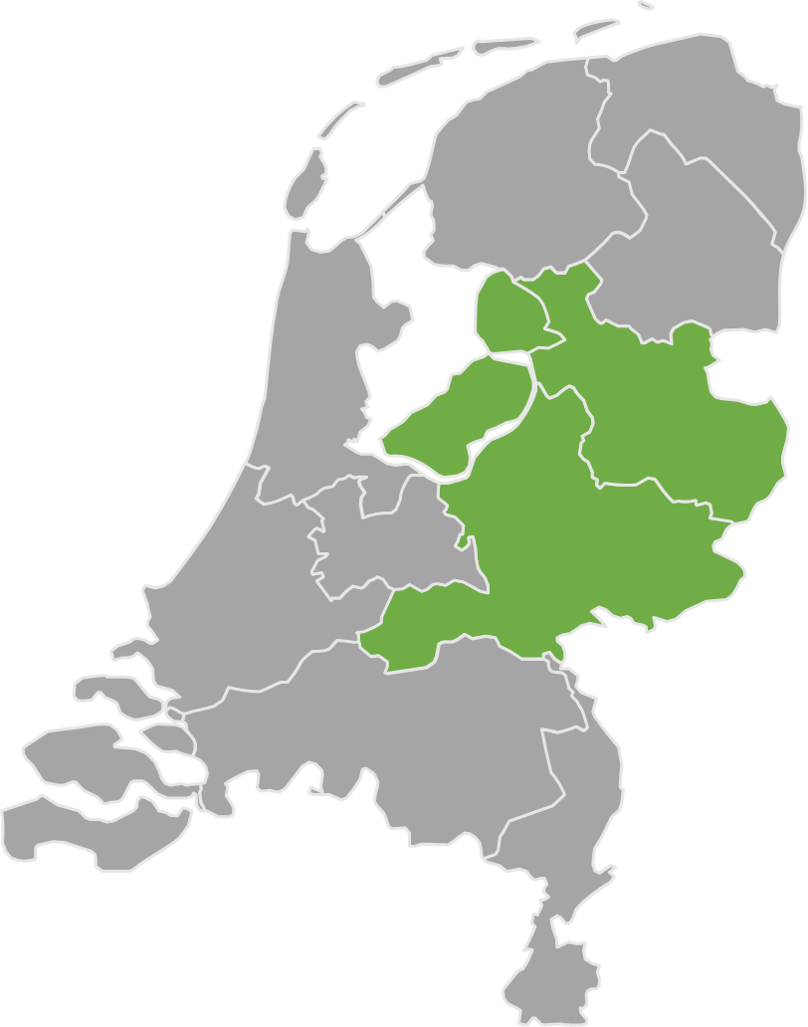
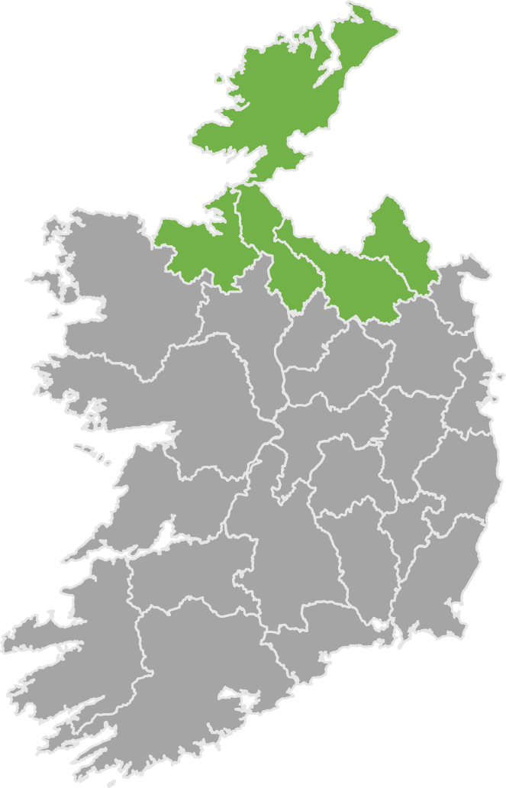
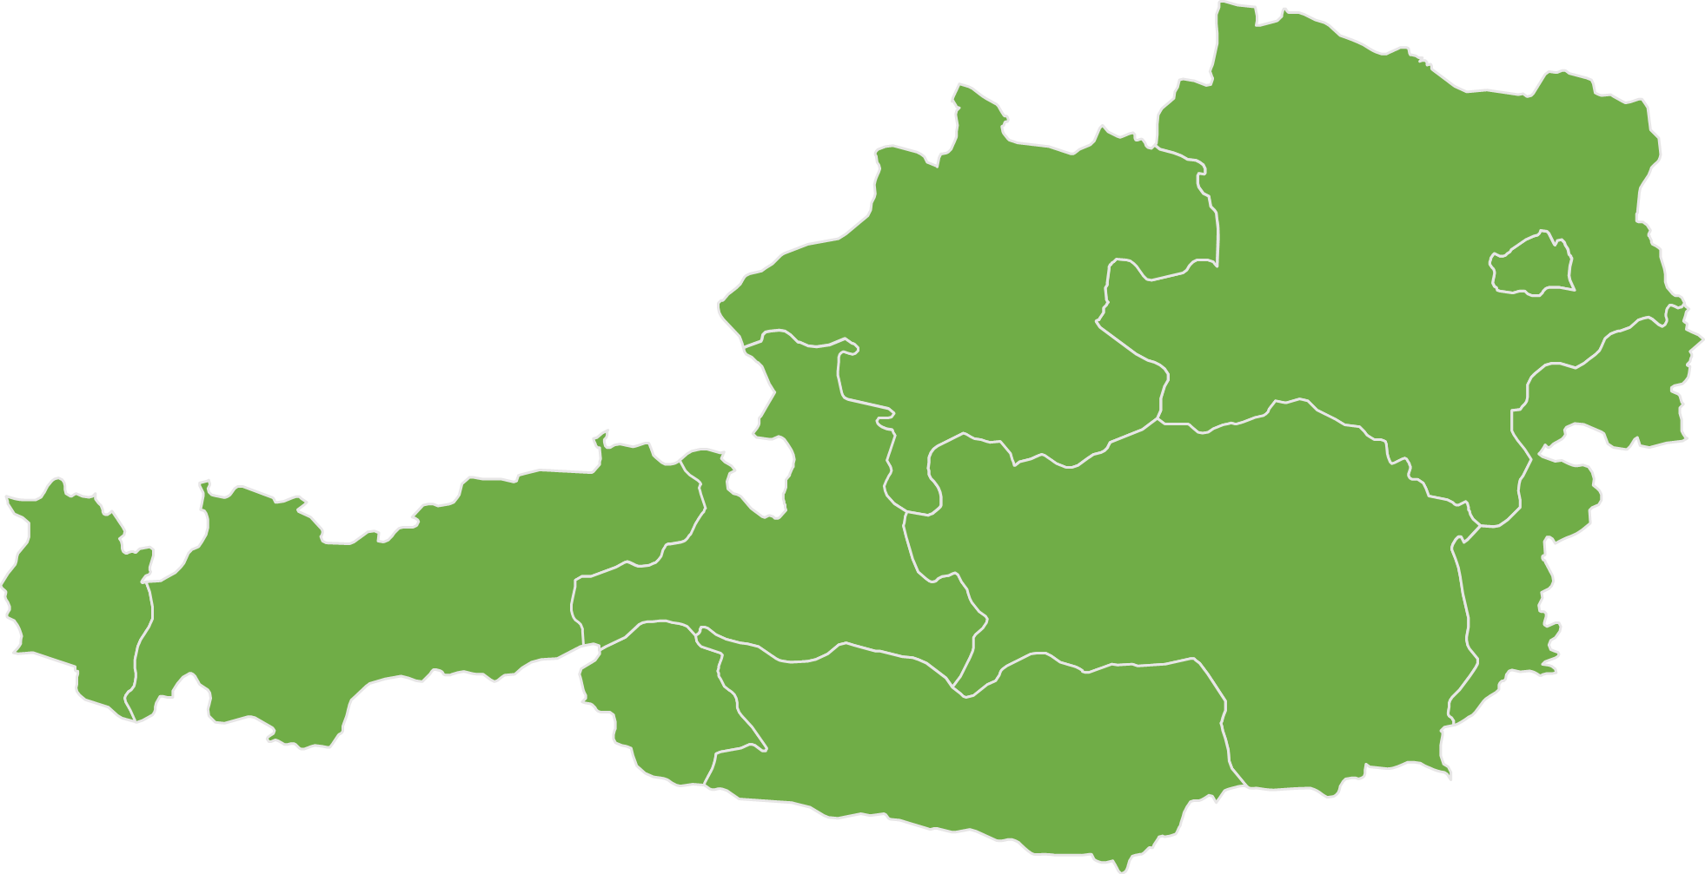
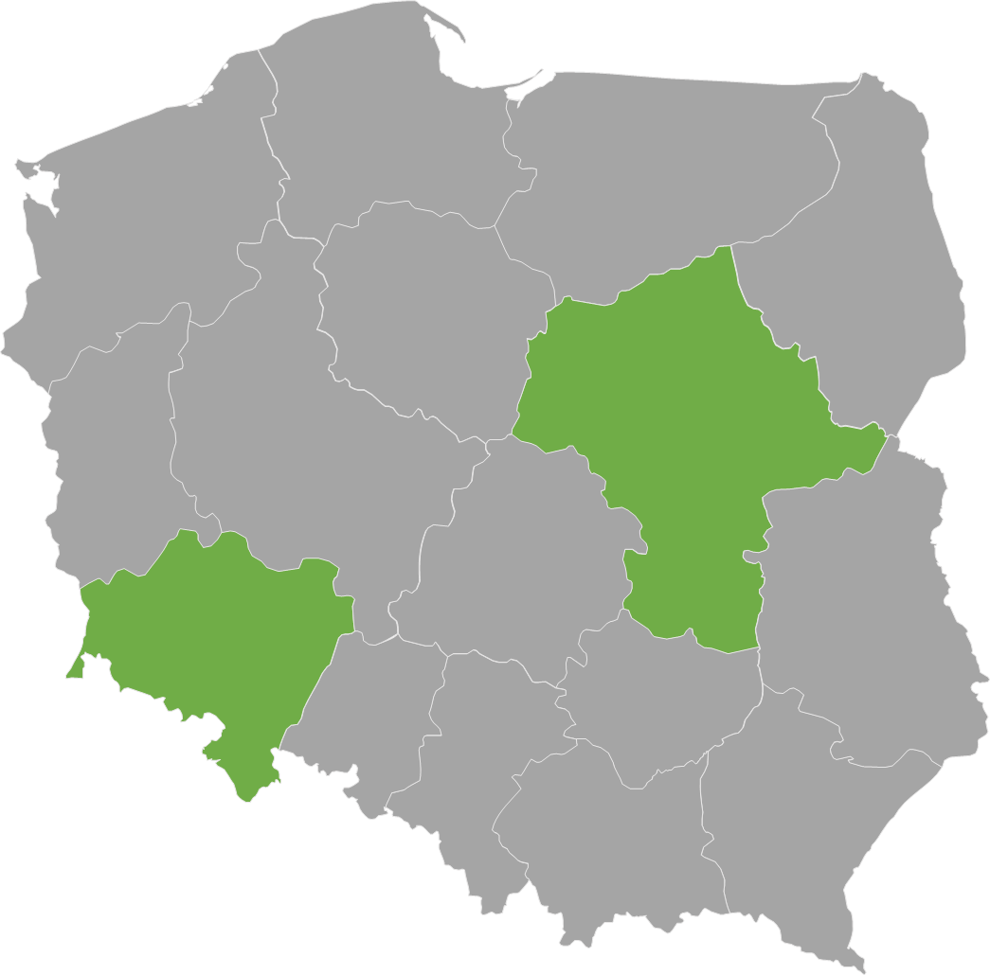
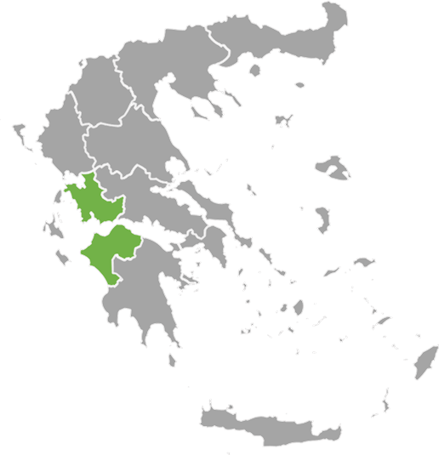
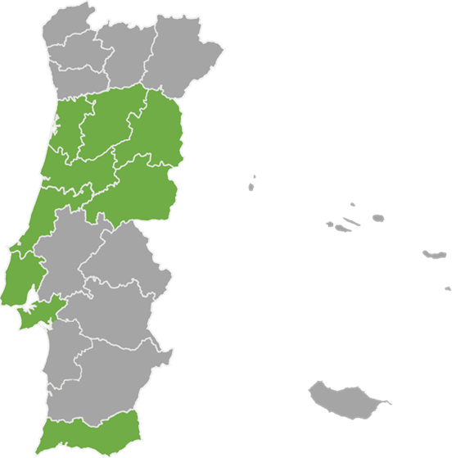
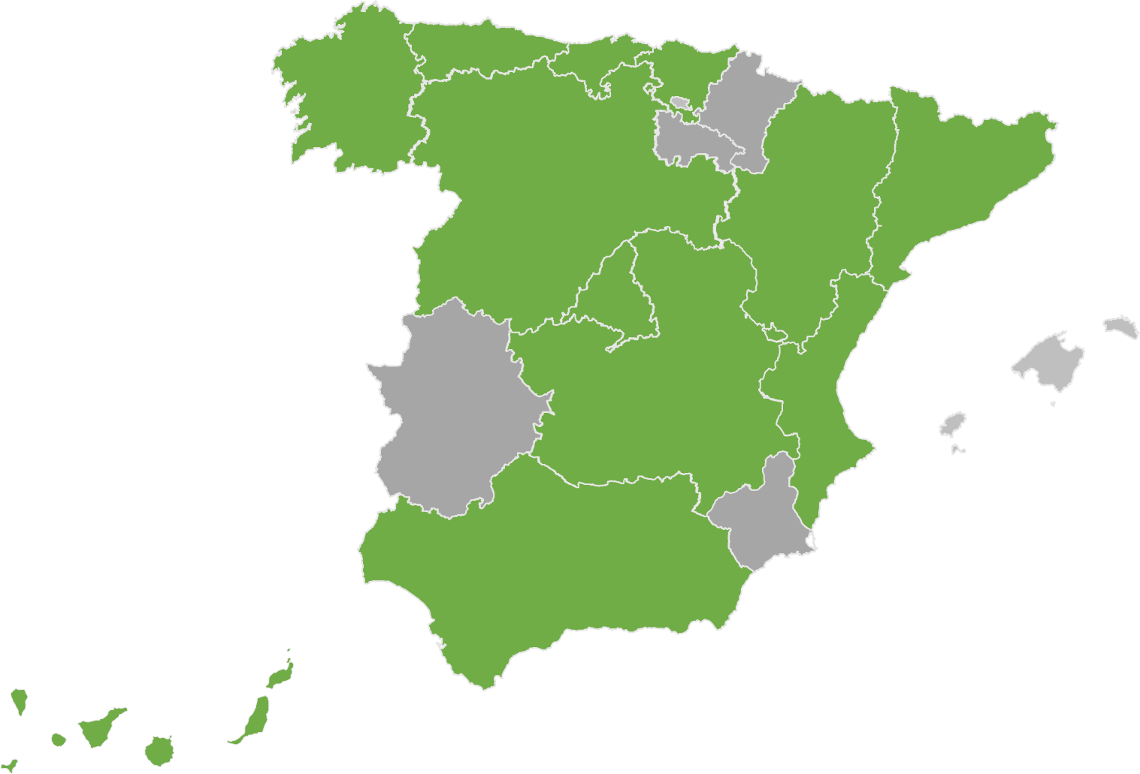
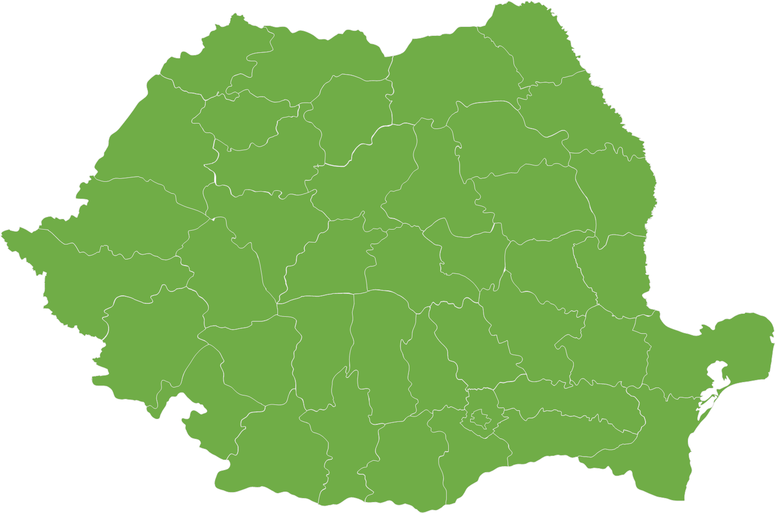
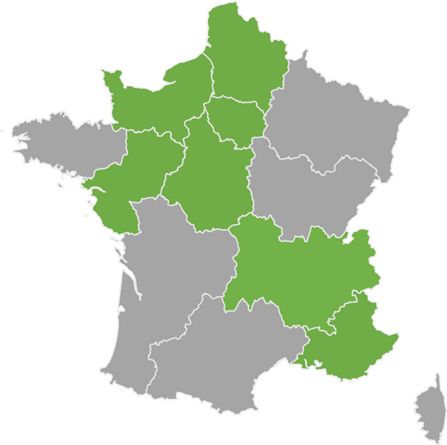

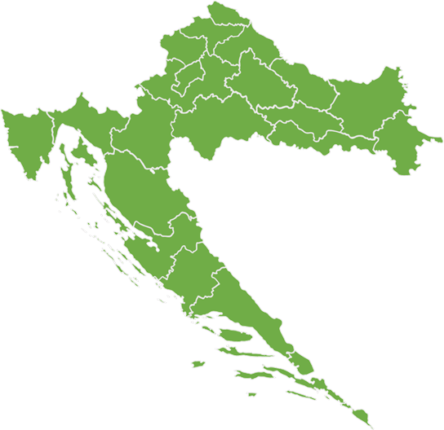
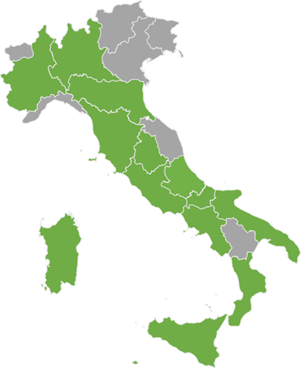
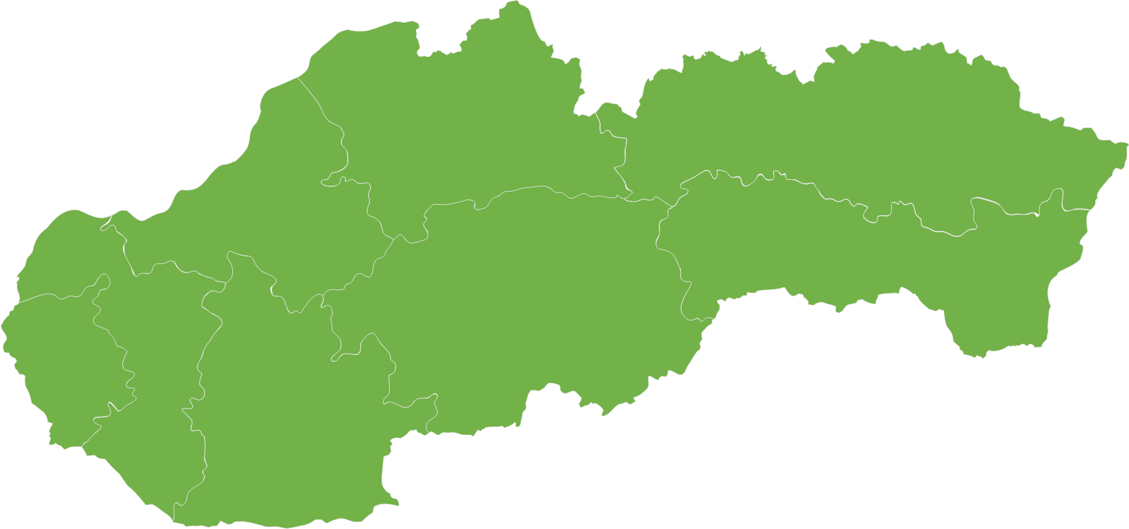
Design Suggestion
STEP Funding under Cohesion Policy (31.12.25)
Latvia – EUR 58m
Belgium – EUR 70m
1 national ERDF programme
2 regional ERDF programmes
EUR 13.7 bn allocation to STEP adopted
Lithuania – EUR 59m
Bulgaria – EUR 161m
1 national ERDF programme
2 national ERDF programmes
Hungary – EUR 545m
Denmark – EUR 65m
1 national ERDF and 1 national ERDF/ESF+ programme
1 national JTF programme
Germany – EUR 1.6 bn
Netherlands – EUR 20m
1 regional ERDF and 1 national JTF programme
12 regional ERDF, 1 regional JTF and
1 regional ESF+ programmes
Austria – EUR 18m
Ireland – EUR 2m
1 national JTF programme*
1 regional ERDF programme
Poland – EUR 956m
Greece – EUR 334m
2 regional and 1 national ERDF programmes
2 national ESF+, 1 National JTF and ERDF and 1 regional ERDF programme
Portugal – EUR 1.3bn
Spain – EUR 1.9 bn
3 regional and 1 national ERDF programmes
13 regional and 1 national ERDF, 6 regional ESF+ and 1 national JTF programmes
Romania – EUR 1.8bn
8 regional and 2 national ERDF, 1 national ESF+, 1 national JTF programmes
France – EUR 214m
Adopted programmes
7 regional multifund programmes
Slovenia – EUR 103m
Italy – EUR 4.2bn
1 national ERDF programme
Croatia – EUR 198m
13 regional and 1 national ERDF, and 2 national and 2 regional ESF+ programmes
Slovakia – EUR 232 m
2 national ERDF programmes
1 national ERDF programme

Slide 3


Reprogramming – Belgium
1 Regional ERDF Programme (EUR 70 mill)
Examples of actions: technological advances in biotechnology, clean and resource-efficient technologies, and digital technologies, and the development of critical skills.
ERDF | Brussels Region | EUR 18 m
 | Flanders | EUR 52 m

Slide 4
Reprogramming – Bulgaria
2 Regional ERDF Programme (EUR 161 mill)
Examples of actions: Support through equity and quasi-equity investments in enterprises, support through a portfolio guarantee debt instrument with a loss cap designed to mitigate the credit risk of investment finance, Supporting the development and building of technology infrastructures for the development or production of technologies, support for STEP Sovereignty Seal or Seal of Excellence projects, skills development in STEP critical technologies
ERDF | Competitiveness and Innovation in Enterprises | EUR 80 m
 | Smart Transformation | EUR 81 m

Slide 5
Reprogramming - Denmark
1 National JTF Programme (EUR 65 million): North and South Jutland
Examples of actions:
  including the related value chains,
  competence and skills development in the enterprises.
  Carbon Capture Utilisation and Storage
JTF | North and South Jutland | EUR 65 m

Slide 6
Reprogramming - Germany
1 Regional ESF+, 1 Regional JTF and 11 Regional ERDF Programmes (EUR 1.6 billion):
Examples of actions: Support to SMEs, large enterprises (in the JTF regions), vocational training and research institutions in the fields of critical digital technologies, biotechnologies, circular economy, deep-tech innovation, green and resource-efficient technologies, technology transfer activities between universities, research organisations and SMEs.
JTF | North Rhine Westphalia | EUR 418 m
ERDF | North Rhine Westphalia | EUR 259 m
 | Baden-Württemberg | EUR 71 m
 | Mecklenburg-Vorpommern | EUR 139 m
 | Bavaria | EUR 105 m
 | Hamburg | EUR 7.2 m
 | Berlin | EUR 10.4 m
 | Thuringia | EUR 20.7 m
 | Brandenburg | EUR 128 m
 | Niedersachsen | EUR 140 m
 | Sachsen-Anhalt | EUR 88 m
 | Saxony | EUR 140 m
 | Schleswig-Holstein | EUR 43 m
ESF+ | Bavaria | EUR 37 m

Slide 7
Reprogramming – Ireland
1 Regional ERDF Programme (EUR 2 mill)
Examples of actions: The Innovators Initiative 2 is designed to enhance deep-tech innovation and entrepreneurship among PhD students in Ireland by offering intensive training modules. It aims to scale nationally, focusing on early-stage deep-tech research to strengthen development of critical technologies and support competitiveness.
ERDF | Northern and Western Ireland | EUR 2 m

Slide 8
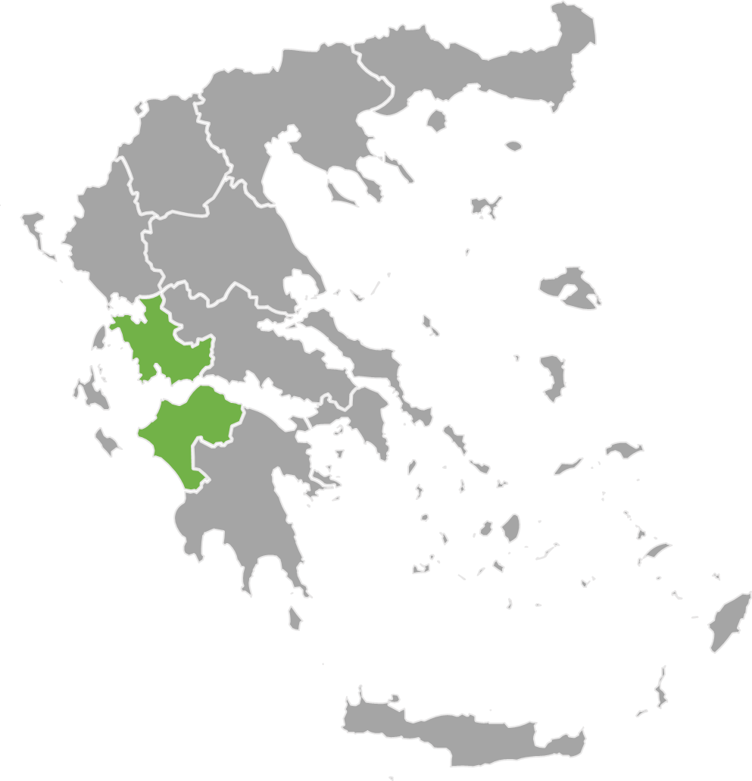
Reprogramming – Greece
2 National ESF+ and JTF, and 1 National and 1 Regional ERDF Programmes (EUR 334 mill)
Examples of actions: development, retraining, and upgrading of digital skills relevant for the development/manufacturing of critical technologies
ESF+ | Human Resources and Social Cohesion | EUR 50 m
 | Digital transformation | EUR 57 m
ERDF | Dytiki Ellada | EUR 8.5 m
 | Competitiveness | EUR 150 m
JTF | Just Development transition | EUR 69 m

Slide 9
Reprogramming - Spain
1 national JTF, 1 national and 11 regional ERDF, 6 regional ESF+ programmes (EUR 1.9 bn):
JTF | National programme | EUR 104
ERDF | C. Valenciana | EUR 144 m
 | Canarias | EUR 21 m
 | Catalonia | EUR 114 m
 | Comunidad de Madrid | EUR 73 m
 | Castille Leon | EUR 45 m
 | Aragon | EUR 23 m
 | Cantabria | EUR 16 m
 | Basque Country | EUR 33 m
 | Andalucía | EUR 244 m
 | Asturias | EUR 15 m
 | Castilla la Mancha | EUR 62 m
 | Galicia | EUR 27 m
 | Plurirregional programme | EUR 9 m
ESF+ | Comunidad de Madrid | EUR 64 m
 | C. Valenciana | EUR 19 m
 | Galicia | EUR 23 m
 | Cantabria | EUR 3 m
 | Catalonia | EUR 19 m
 | Canarias | EUR 2.1 m
Examples of actions: advanced facilities to enhance photonic chips, quantum computing, public-private R&D&I partnerships involving SMEs and large enterprise, support for advanced projects labelled the Horizon Europe Seal of Excellence, artificial intelligence, semiconductors and clean technologies.

Slide 10

Reprogramming - France
7 multifund programmes (ESF+, ERDF and JTF) (EUR 214 million):
  Other programmes under assessment by the European Commission
  Examples of actions: support to skills for the development and/or production activities of STEP technologies, financial instruments for industrial startups and innovative SMEs (deep tech innovation, digital, clean and resource-efficient technologies)
ERDF, ESF+ and JTF | Île de France | EUR 48 m
 | Auvergne-Rhone-Alpes | EUR 10 m
 | Pays de la Loire | EUR 6 m
 | Normandie | EUR 26 m
 | Hauts de France | EUR 53 m
 | Sud-Provence Alpes-Côte d’Azur | EUR 60 m
 | Centre-Val de Loire | EUR 12 m

Slide 11
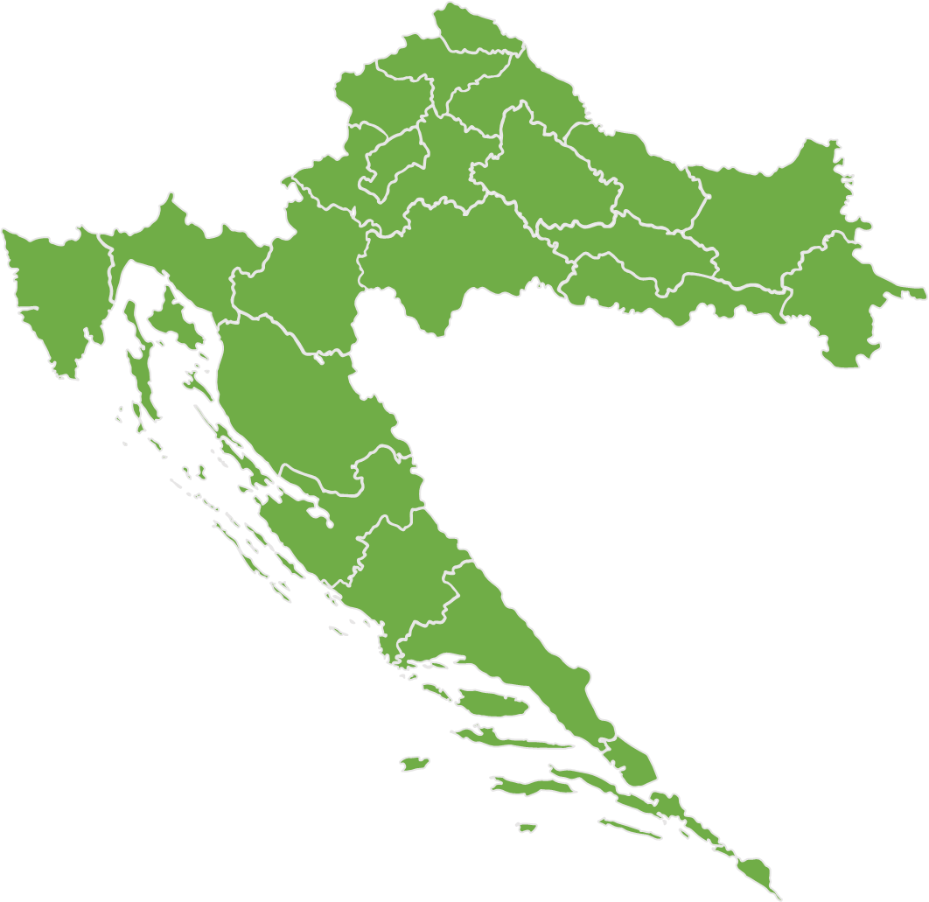
Reprogramming – Croatia
1 National ERDF programme (EUR 198 mill)
Examples of actions: development of critical and emerging technologies relevant for the green and digital transitions, from computing technologies, including microelectronics, quantum computing and artificial intelligence, to biotechnology and biomanufacturing and net-zero technologies.
ERDF | National programme | EUR 48 m
 | Integrated Territorial Programme | EUR 150

Slide 12
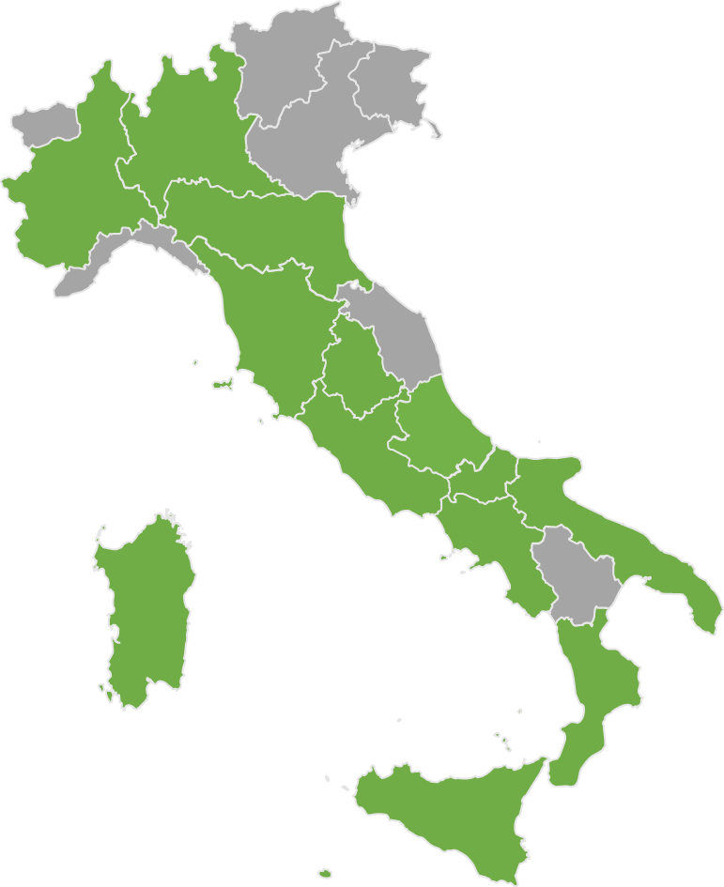
Reprogramming - Italy
1 National ERDF, 2 National ESF+ and 13 Regional ERDF and 2 Regional ESF+ Programmes (EUR 4.2 billion):
ERDF | National Research and Innovation | EUR 602 m
 | Lombardy | EUR 120 m
 | Emilia Romagna | EUR 61 m
 | Tuscany | EUR 98 m
 | Umbria | EUR 31 m
 | Lazio | EUR 109 m
 | Campania | EUR 581 m
 | Abruzzo | EUR 35 m
 | Apulia | EUR 471 m
 | Calabria | EUR 264 m
 | Molise | EUR 45 m
 | Piemonte | EUR 100 m
 | Sicily | EUR 615 m
 | Sardinia | EUR 166 m
ESF+ | Youth, Women and Jobs | EUR 200 m
 | School and Skills | EUR 646 m
 | Abruzzo | EUR 25 m
 | Sicily | EUR 60 m
Examples of actions: pharmaceuticals, aerospace, and cloud computing, tissue and cell engineering, green hydrogen, onshore and offshore wind energy, mechanics and mechatronics, quantum computing.

Slide 13
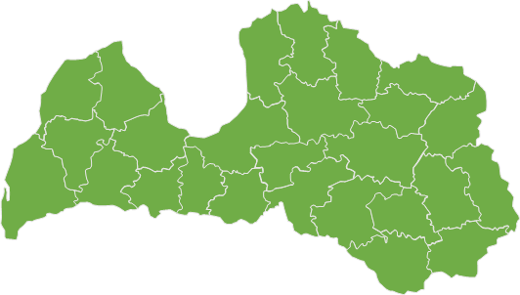
Reprogramming – Latvia
1 National ERDF Programme (EUR 57 million):
Examples of actions: Development of a high-capacity port and logistics infrastructure to attract RES (wind energy technology) component manufacturing companies in Latvia and support programmes for the development of critical marine wind technologies:
ERDF | National | EUR 57 m

Slide 14
Reprogramming – Lithuania
1 National ERDF Programme (EUR 59 million)
Examples of actions: acquisition and development of technologies, developing high-value-added industries, technologies in the field of defence and security, including special features and special machinery, provide cumulative or alternative funding to projects with a STEP Seal.
ERDF | National | EUR 59 m

Slide 15
Reprogramming – Hungary
1 National ERDF and 1 national ERDF/ESF+ Programme (EUR 545 million)
Examples of actions: Support for Important Projects of Common European Interest (IPCEI), Support for complex development of technological infrastructures, development/manufacturing of critical digital technologies, through grants and venture capital programmes, technical support for the development of critical and relevant skills for the development/production of critical STEP technologies.
ERDF | Economic Development and Innovation Operational Programme Plus (EDIOP Plus) | EUR 245 m
ERDF/ESF+ | Digital Renewal Plus (DROP +) | EUR 300 m

Slide 16
Reprogramming – The Netherlands
1 regional ERDF and one national JTF programme* (EUR 20 mill)
Examples of actions: Experimental developments on renewable energy, Innovation pathways in SMEs, smart energy systems or battery technologies and energy storage technologies, experimental gardens and livinglabs, demonstrations of new applications and solutions
ERDF | East Netherlands | EUR 16 m
JTF | National programme | EUR 4 m

Slide 17
Reprogramming – Austria
1 National JTF Programme* (EUR 18 mill)
Examples of actions: digital technologies and deep tech innovations, clean and resource-efficient technologies and biotechnologies, skills to diversify into green business and accompanying companies in transition
JTF | National programme | EUR 18 m

Slide 18
Reprogramming – Poland
1 national and 2 regional ERDF Programmes (EUR 956 million):
Examples of actions: biotechnologies, focusing on research to develop new treatments using gene therapy for the treatment of Parkinson disease, support to Polish companies in the implementation of projects characterized by a high level of innovation in digital technologies.
ERDF | Mazowsze | EUR 35 m
ERDF | Dolny Śląsk | EUR 20 m
ERDF | Smart Economy | EUR 901 m

Slide 19

Reprogramming – Portugal
1 National ERDF and 3 Regional ERDF Programme (EUR 1.3 bn)
Examples of actions: Supports business investments in R&I and production for clean, resource-efficient, and zero-impact technologies, focused on decarbonisation, energy efficiency, and renewable energy, aligned with the RIS3 strategy.
ERDF | Innovation and Digital Transition Thematic Programme | EUR 1.1 bn
 | Centro | EUR 30 m
 | Algarve | EUR 20 m
 | Lisbon | EUR 38 m

Slide 20
Reprogramming - Romania
2 National and 8 Regional ERDF, 1 JTF and 1 ESF+ National programmes (EUR 1.8 billion):
Examples of actions: public research projects on AI, hydrogen, and semiconductors, biotech, AI, and robotics in healthcare, training healthcare professionals, investments in STEP technologies by SMEs and industrial installations.
JTF | National | EUR 266 m
ERDF | Smart Growth | EUR 271 m
 | Health | EUR 466 m
 | South-West Oltenia | EUR 28 m
 | North East | EUR 6 m
 | South East | EUR 10 m
 | Central region | EUR 11 m
 | West | EUR 20 m
 | South Muntenia | EUR 10 m
 | North-West | EUR 10 m
 | Bucharest-Ilfov | EUR 70 m
ESF+ | Employment and Education | EUR 573 m

Slide 21
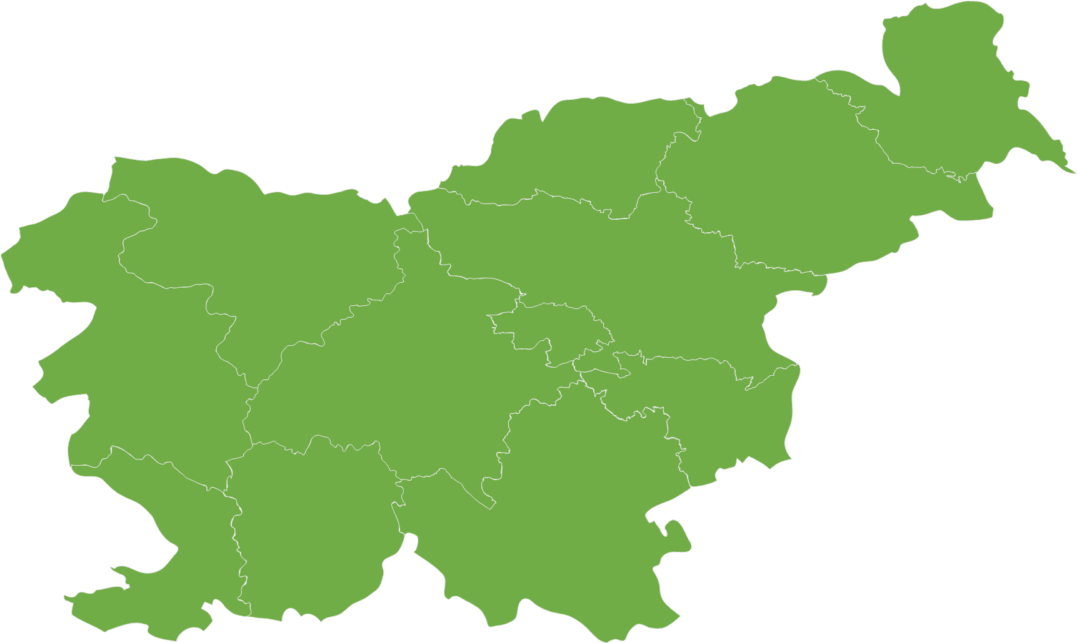
Reprogramming – Slovenia
1 National ERDF Programme (EUR 103 mill)
Examples of actions: research and innovation projects (TRL 4–9) with the aim of transitioning to commercial production and projects aimed at establishing production, support for projects with the sovereignty seal (STEP seal), and support to projects in the areas of biotechnology (field of pharmaceuticals and related disciplines) and digital technologies (particularly in the field of chips and semiconductors).
ERDF | National programme | EUR 103 m

Slide 22
Reprogramming – Slovakia
1 National ERDF Programme (EUR 232 mill)
Examples of actions: productive investments, and industrial research in the areas of digital technologies, cybersecurity technologies, robotics technologies, artificial intelligence technologies, energy technologies, eco-innovation technologies, biotechnologies and semiconductor technologies
ERDF | National programme | EUR 232 m

