Slide 1
Strategic Technologies for Europe Platform (STEP)
Overview of Cohesion Policy
amendment adoptions per Member State
https://strategic-technologies.europa.eu

Slide 2
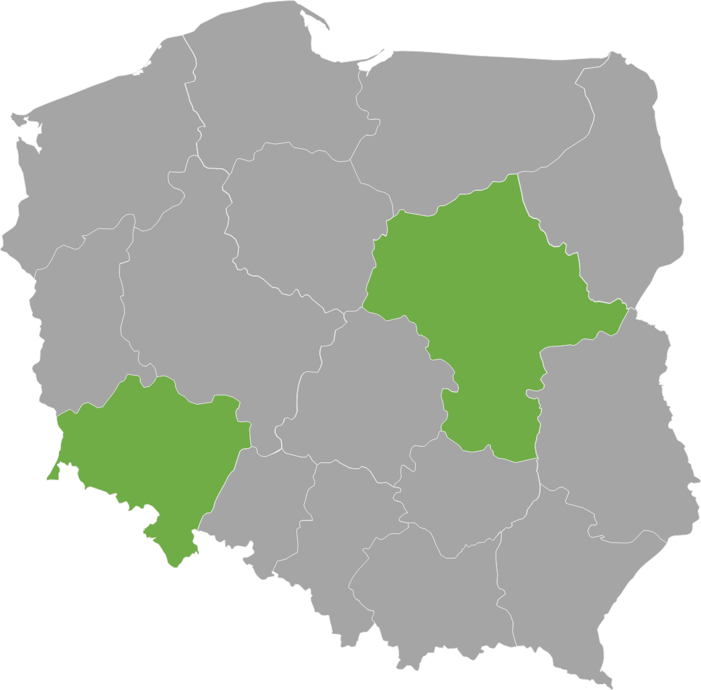
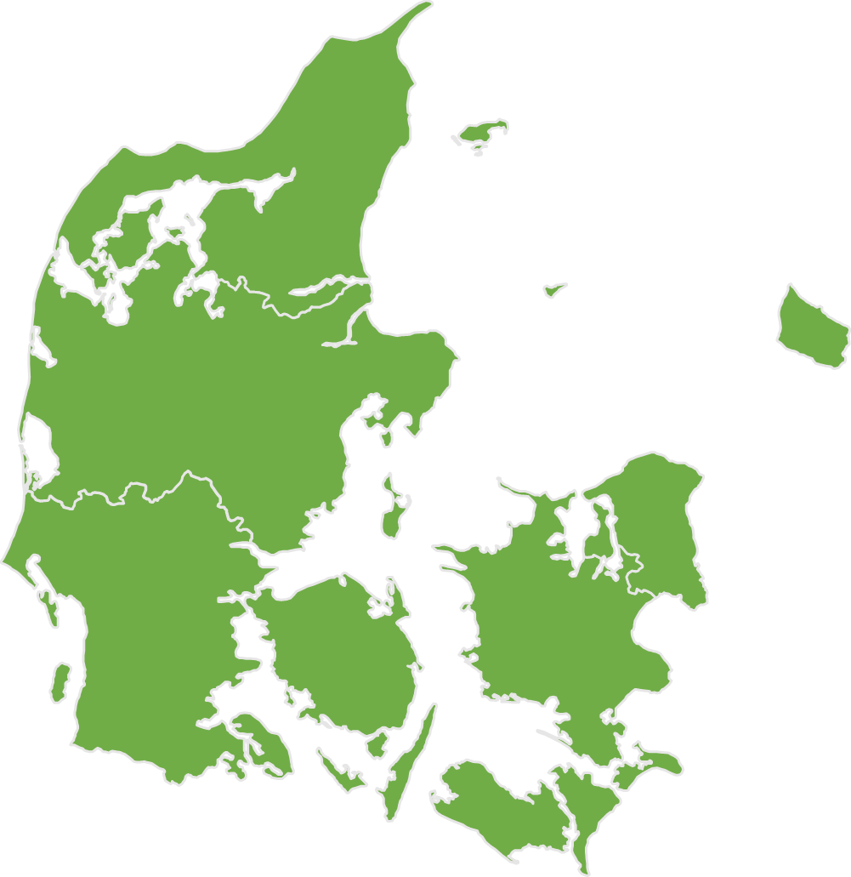
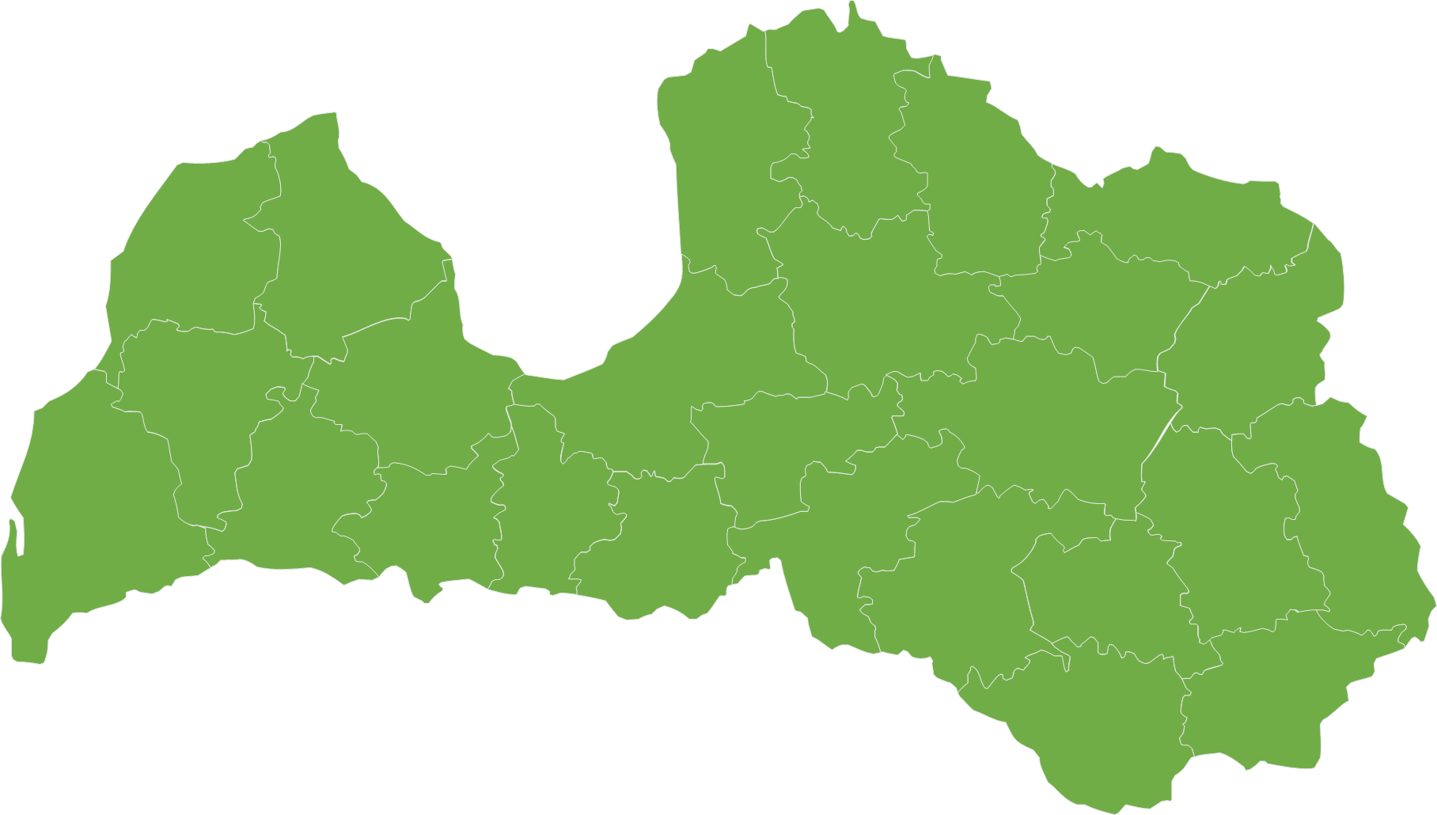
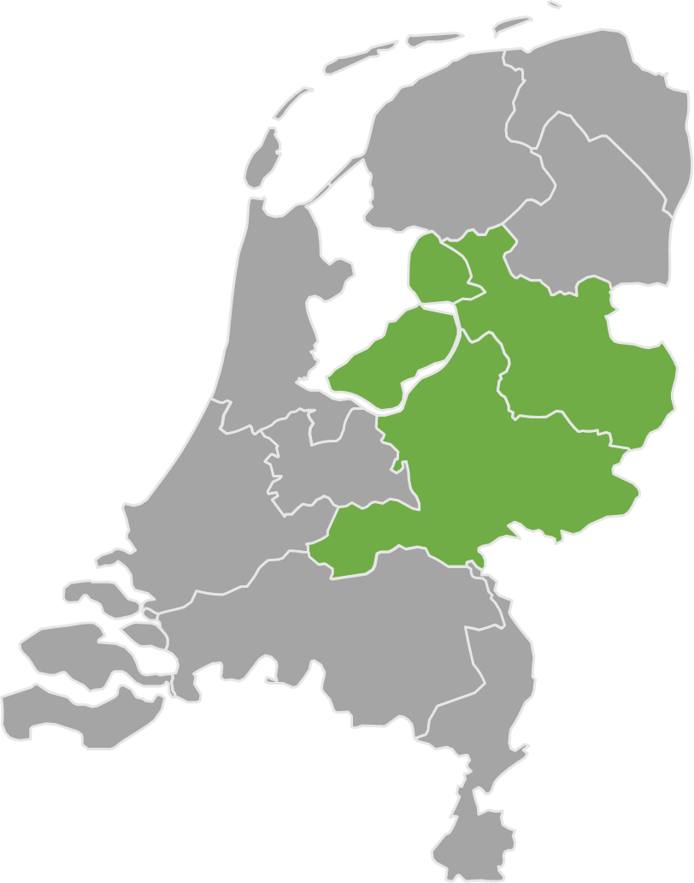
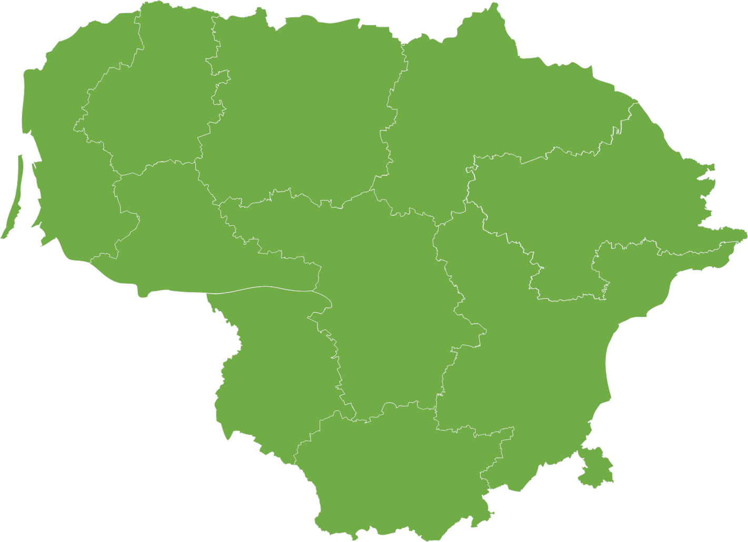
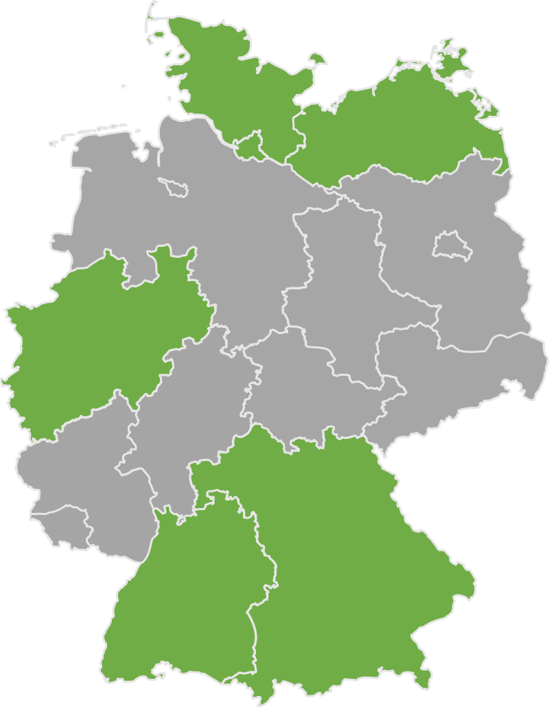
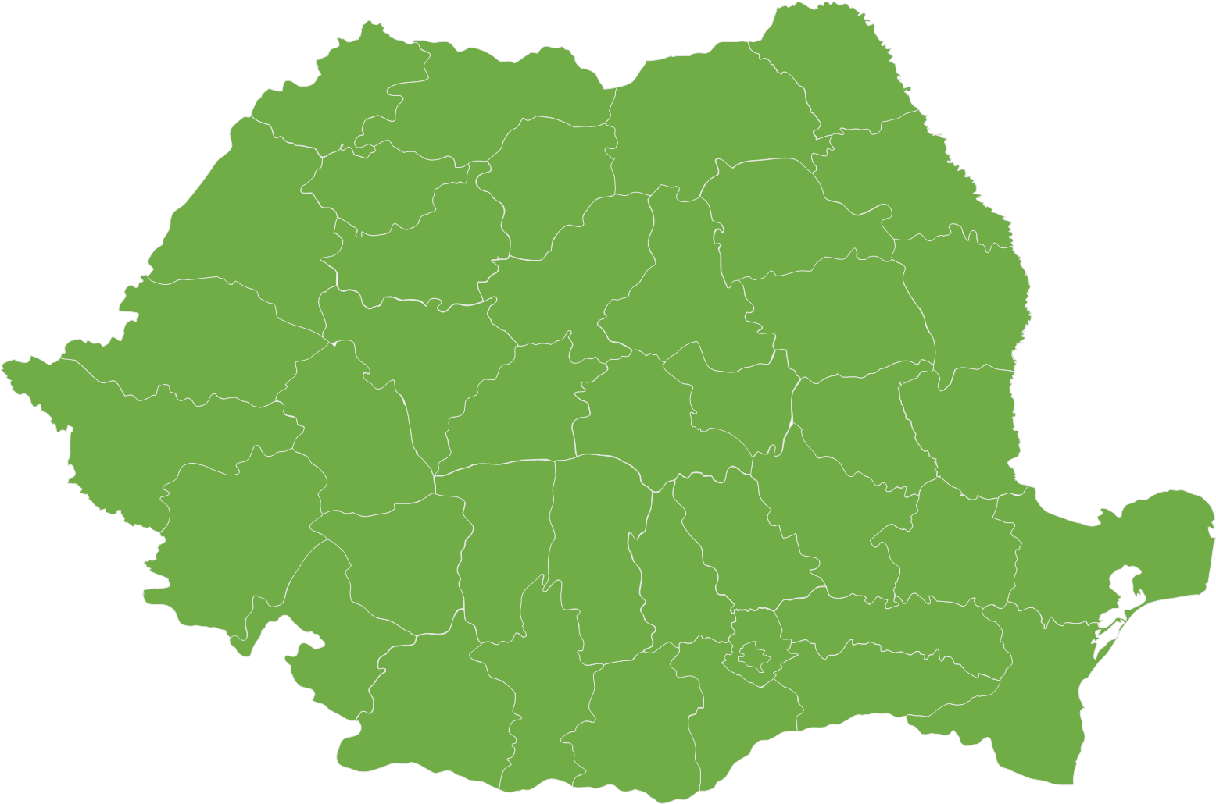
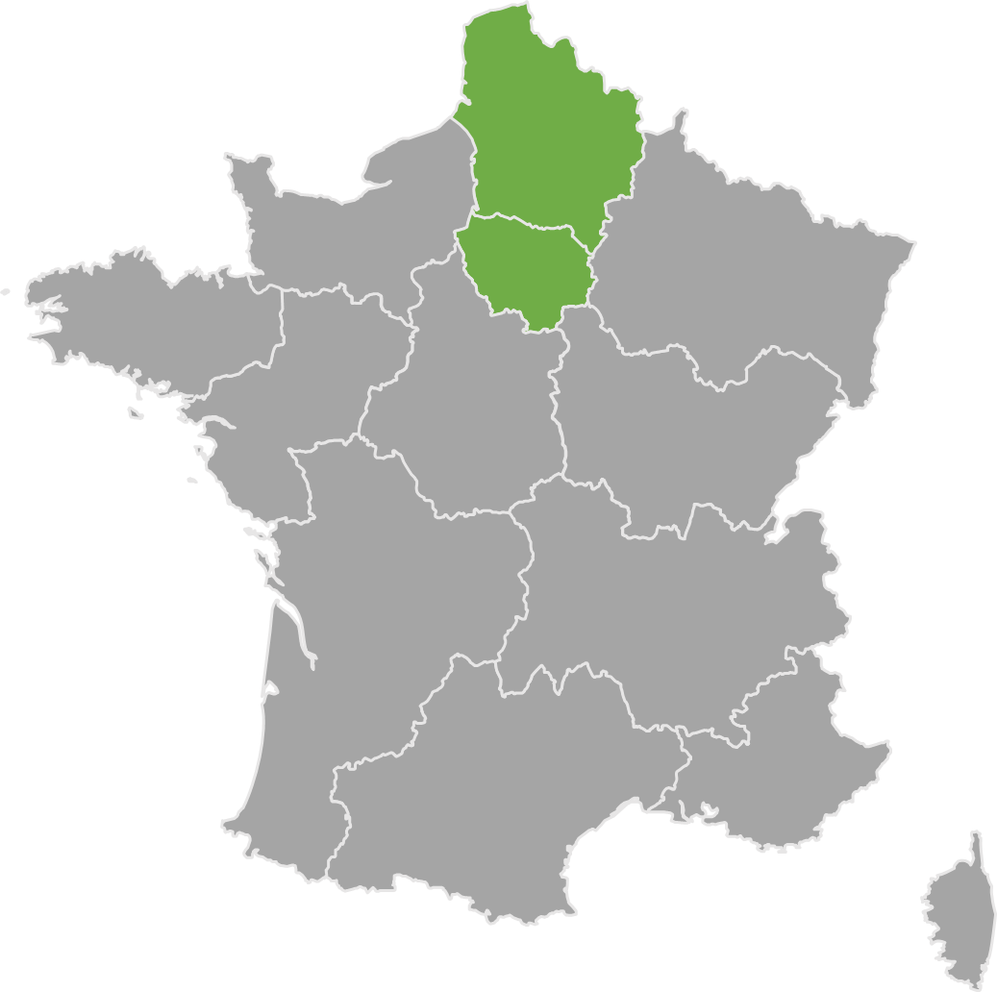
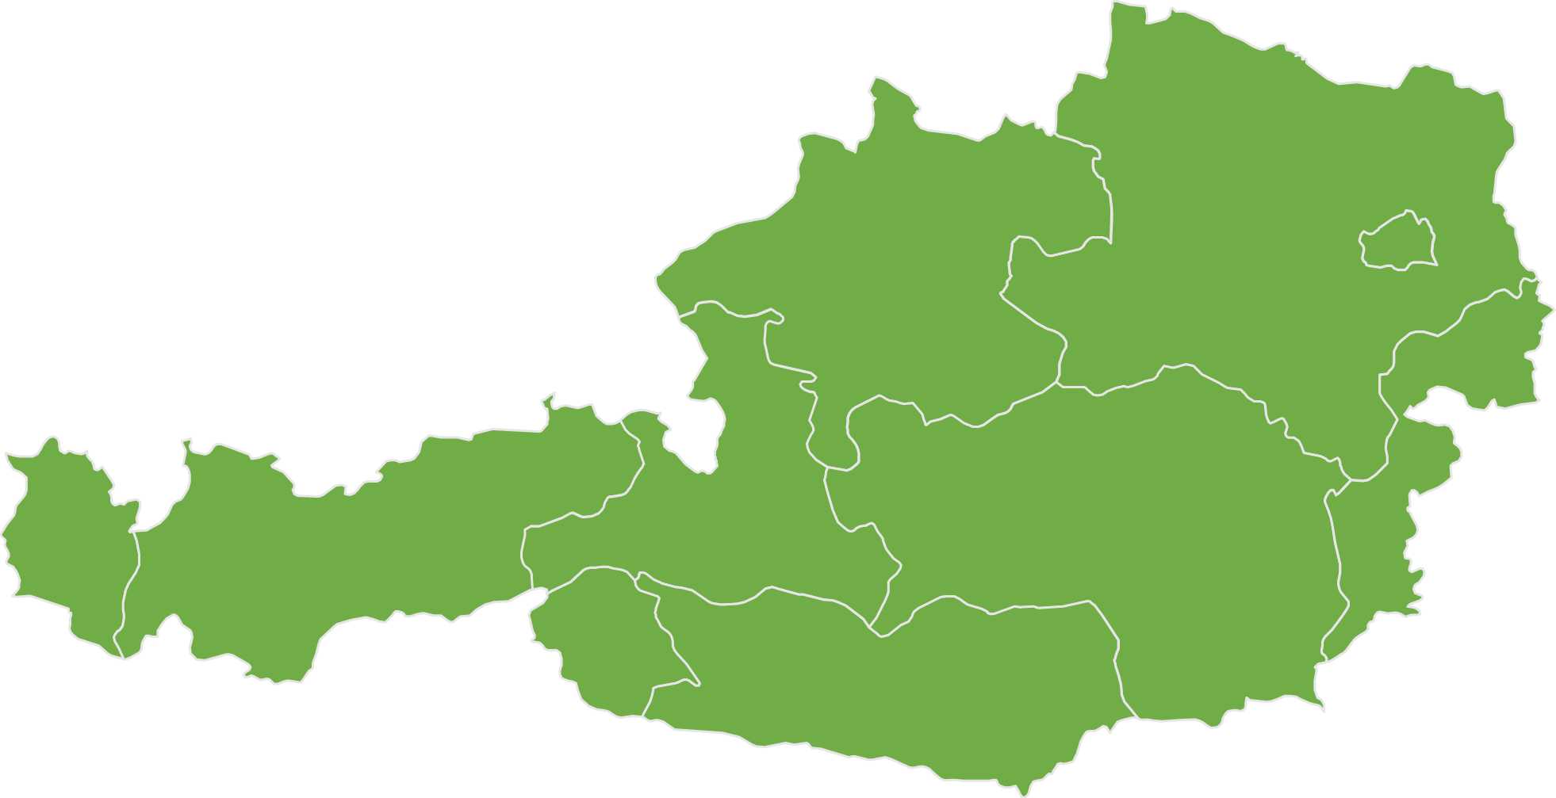
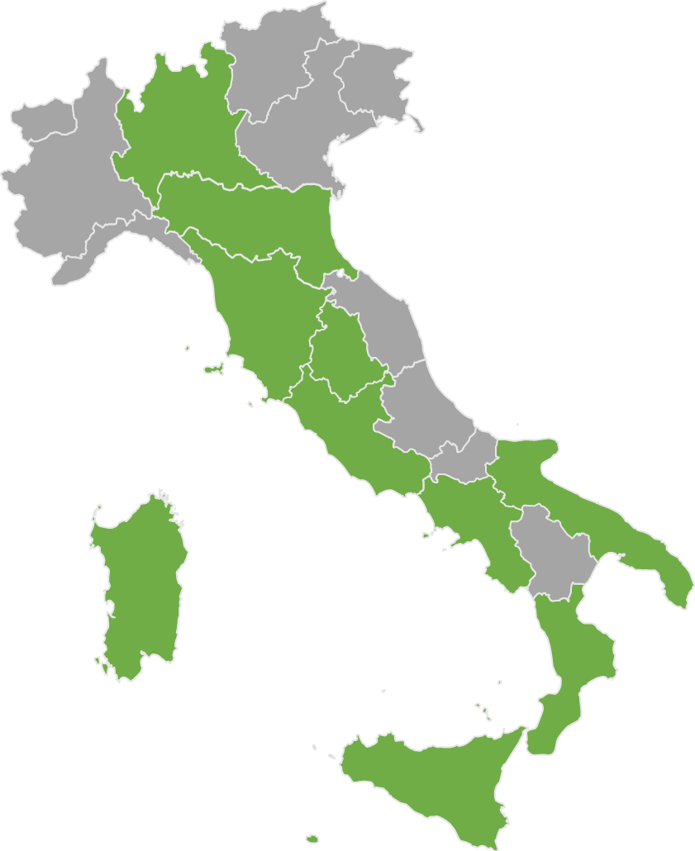
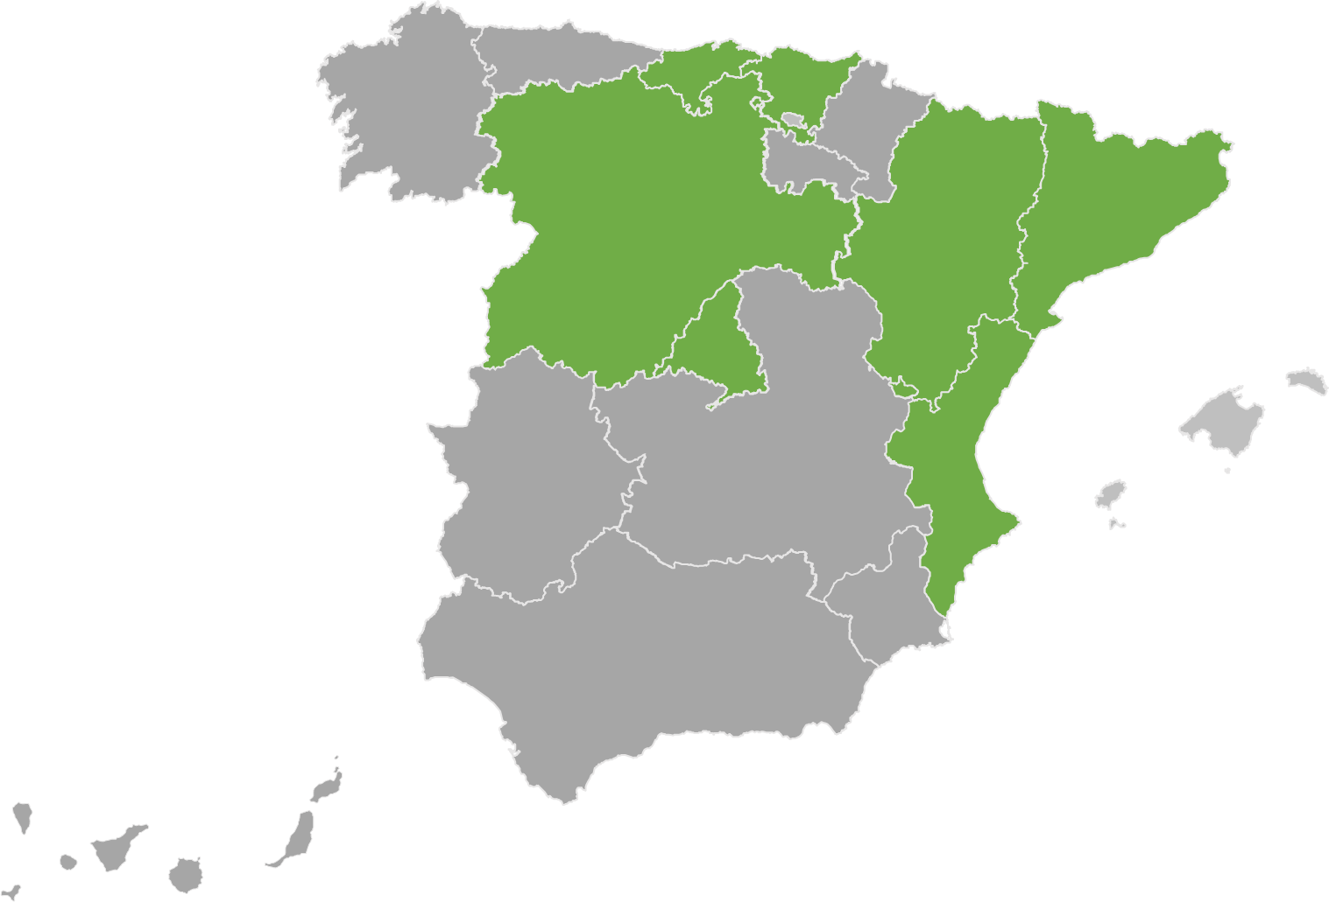
STEP (last update 04/06/2025)
Poland – EUR 956m
1 national and 2 regional ERDF programmes
Denmark – EUR 52m
1 national JTF programme
Latvia – EUR 57m
1 national ERDF programme
Netherlands – EUR 20m
1 regional ERDF and 1 national JTF* programme
Lithuania – EUR 59m
1 national ERDF programme
Germany – EUR 894m
6 regional ERDF, 1 regional JTF and
1 regional ESF+ programmes
Romania – EUR 1.6bn
1 national ESF+,
2 national ERDF and 1 national JTF programmes
France – EUR 83m
2 regional ERDF and ESF+ programmes
Austria – EUR 18m
1 national JTF programme*
Spain – EUR 523m
Submitted programmes
Italy – EUR 3.1bn
7 regional and 1 national ERDF, 2 regional ESF+ programmes
Adopted programmes
10 regional and
1 national ERDF programme
*mainstreaming of STEP/STEP priority not included
Notes:
6 MS, 33 programme amendments for ERDF, JTF and ESF+
Clean tech, digital tech, biotech and skills covered.
2nd wave + it can happen after too

Slide 3
Reprogramming - Germany
1 Regional ESF+, 1 Regional JTF and 6 Regional ERDF Programmes (EUR 894 million):
Other programmes under assessment by the European Commission
Examples of actions: Support to SMEs, large enterprises (in the JTF regions), vocational training and research institutions in the fields of critical digital technologies, biotechnologies, circular economy, deep-tech innovation, green and resource-efficient technologies, technology transfer activities between universities, research organisations and SMEs.
JTF | North Rhine Westphalia* | EUR 301 m
ERDF | North Rhine Westphalia* | EUR 200 m
 | Baden-Württemberg | EUR 62 m
 | Mecklenburg-Vorpommern | EUR 139 m
 | Bavaria | EUR 105 m
 | Hamburg | EUR 7.2
 | Schleswig-Holstein | EUR 43 m
ESF+ | Bavaria | EUR 37 m
*new programme version submitted, under assessment by the EC

Slide 4

Reprogramming - Spain
1 national and 7 regional ERDF and 2 regional ESF+ programmes (EUR 523 million):
Other programmes under assessment by the European Commission
Examples of actions: green lithium production for the automotive sector, advanced facilities to enhance photonic chips, quantum computing, public-private R&D&I partnerships involving SMEs and large enterprise, support for advanced projects labelled the Horizon Europe Seal of Excellence, artificial intelligence, semiconductors and clean technologies.
ERDF | C. Valenciana | EUR 144 m
 | Catalonia | EUR 114 m
 | Comunidad de Madrid | EUR 73 m
 | Castille Leon | EUR 45 m
 | Aragon | EUR 23 m
 | Cantabria | EUR 16 m
 | Basque Country | EUR 33 m
 | Plurirregional programme* | EUR 9 m
ESF+ | Comunidad de Madrid | EUR 64 m
 | Cantabria | EUR 3 m
*new programme version submitted, under assessment by the EC

Slide 5
Reprogramming - Italy
1 National ERDF and 10 Regional ERDF Programmes (EUR 3.1 billion):
Other programmes under assessment by the European Commission
Examples of actions: pharmaceuticals, aerospace, and cloud computing, tissue and cell engineering, green hydrogen, onshore and offshore wind energy, mechanics and mechatronics, quantum computing.
ERDF | National Research and Innovation | EUR 601 m
 | Lombardy | EUR 120 m
 | Emilia Romagna | EUR 61 m
 | Tuscany | EUR 98 m
 | Umbria | EUR 31 m
 | Lazio | EUR 109 m
 | Campania | EUR 581 m
 | Apulia | EUR 471 m
 | Calabria | EUR 264 m
 | Sicily | EUR 615 m
 | Sardinia | EUR 166 m

Slide 6
Reprogramming - France
2 regional ESF+ programmes and 1 regional ERDF (EUR 83 million):
  Other programmes under assessment by the European Commission
  Examples of actions: support to skills for the development and/or production activities of STEP technologies, financial instruments for industrial startups and innovative SMEs (deep tech innovation, digital, clean and resource-efficient technologies)
ERDF | Île de France | EUR 35 m
ESF+ | Île de France | EUR 12 m
 | Hauts de France* | EUR 34 m
*new programme version submitted, under assessment by the EC

Slide 7
Reprogramming - Denmark
1 National JTF Programme (EUR 52 million): North and South Jutland
Examples of actions:
  including the related value chains,
  competence and skills development in the enterprises.
  Carbon Capture Utilisation and Storage
JTF | North and South Jutland | EUR 52 m

Slide 8
Reprogramming - Romania
2 ERDF, 1 JTF and 1 ESF+ National programmes (EUR 1.6 billion):
Other programmes under assessment by the European Commission
Examples of actions: public research projects on AI, hydrogen, and semiconductors, biotech, AI, and robotics in healthcare, training healthcare professionals, investments in STEP technologies by SMEs and industrial installations.
JTF | National | EUR 266 m
ERDF | Smart Growth | EUR 271 m
 | Health | EUR 466 m
ESF+ | Employment and Education | EUR 573 m

Slide 9
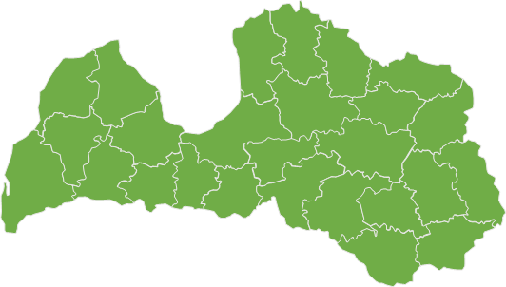
Reprogramming – Latvia
1 National ERDF Programme (EUR 56 million):
Examples of actions: Development of a high-capacity port and logistics infrastructure to attract RES (wind energy technology) component manufacturing companies in Latvia and support programmes for the development of critical marine wind technologies:
ERDF | National | EUR 56 m

Slide 10
Reprogramming – Lithuania
1 National ERDF Programme (EUR 59 million)
Examples of actions: acquisition and development of technologies, developing high-value-added industries, technologies in the field of defence and security, including special features and special machinery, provide cumulative or alternative funding to projects with a STEP Seal.
ERDF | National | EUR 59 m

Slide 11
Reprogramming – The Netherlands
1 regional ERDF and one national JTF programme* (EUR 20 mill)
Examples of actions: Experimental developments on renewable energy, Innovation pathways in SMEs, smart energy systems or battery technologies and energy storage technologies, experimental gardens and livinglabs, demonstrations of new applications and solutions
ERDF | East Netherlands | EUR 16 m
JTF | National programme | EUR 4 m

Slide 12
Reprogramming – Poland
1 national and 2 regional ERDF Programmes (EUR 956 million):
Examples of actions: biotechnologies, focusing on research to develop new treatments using gene therapy for the treatment of Parkinson disease, support to Polish companies in the implementation of projects characterized by a high level of innovation in digital technologies.
ERDF | Mazowsze | EUR 35 m
ERDF | Dolny Śląsk | EUR 20 m
ERDF | Smart Economy | EUR 901 m

Slide 13
Reprogramming – Austria
1 National JTF Programme* (EUR 18 mill)
Examples of actions: digital technologies and deep tech innovations, clean and resource-efficient technologies and biotechnologies, skills to diversify into green business and accompanying companies in transition
JTF | National programme | EUR 18 m
*new programme version submitted, under assessment by the EC

