Slide 1
Strategic Technologies for Europe Platform (STEP)
Overview of Cohesion Policy
amendment adoptions per Member State
https://strategic-technologies.europa.eu

Slide 2
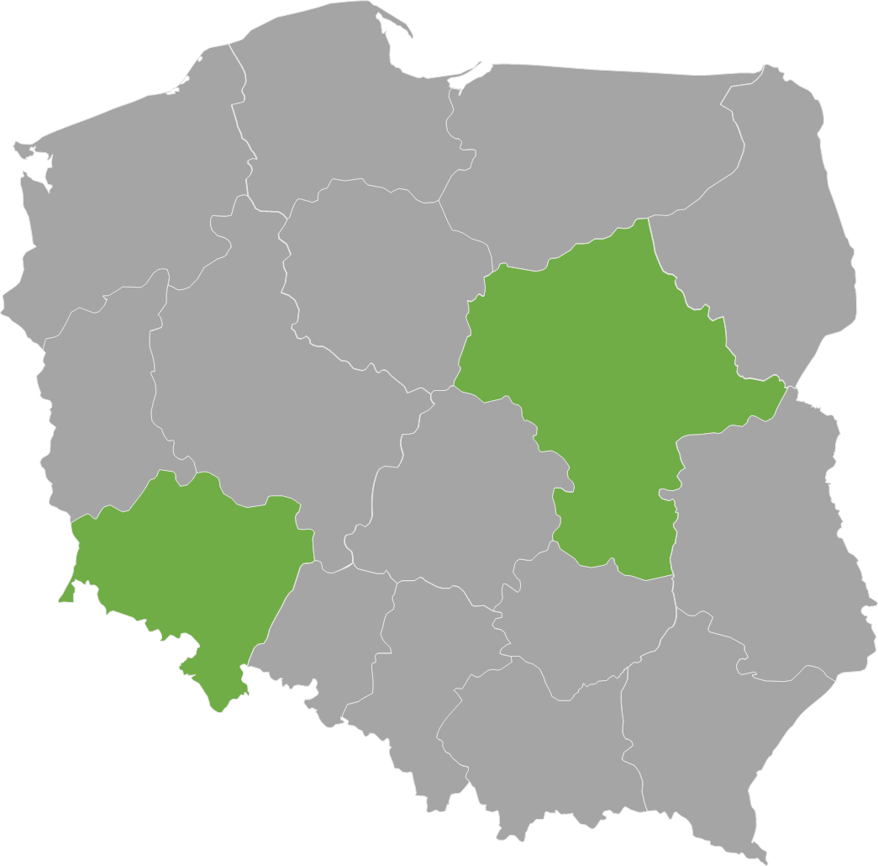
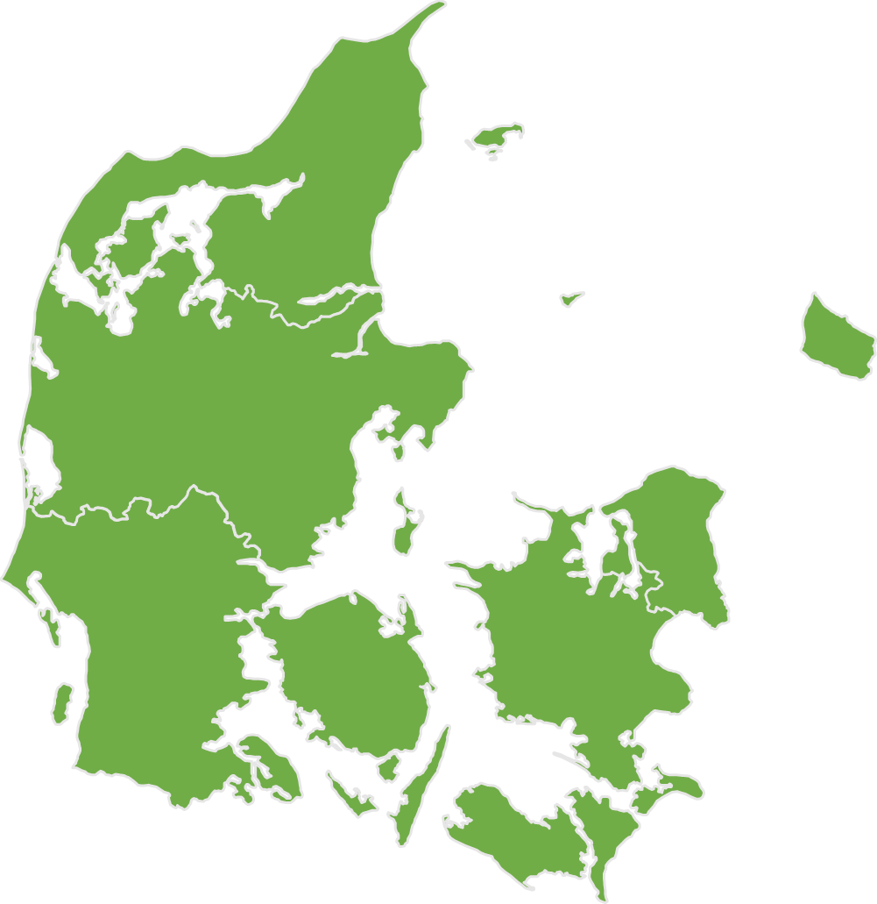
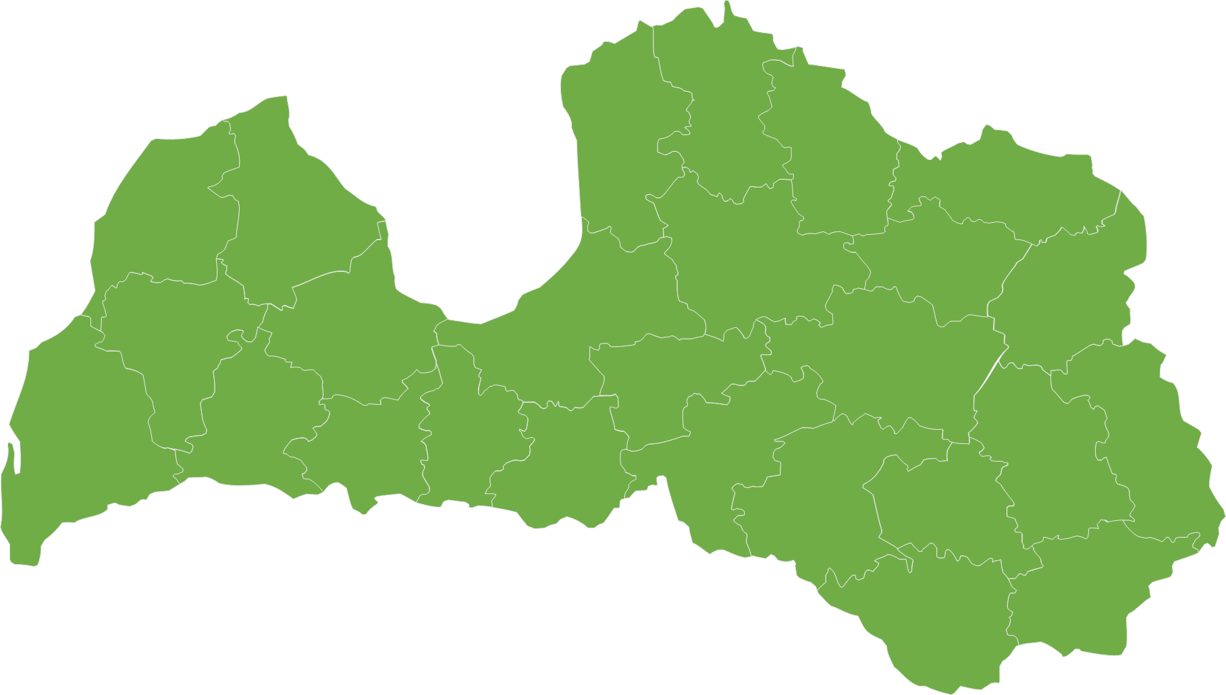
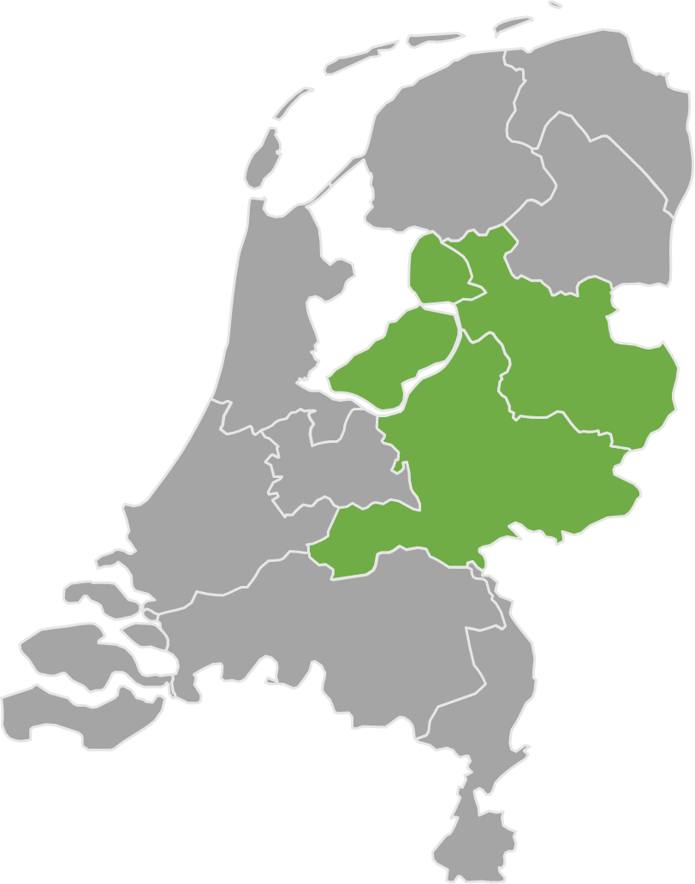
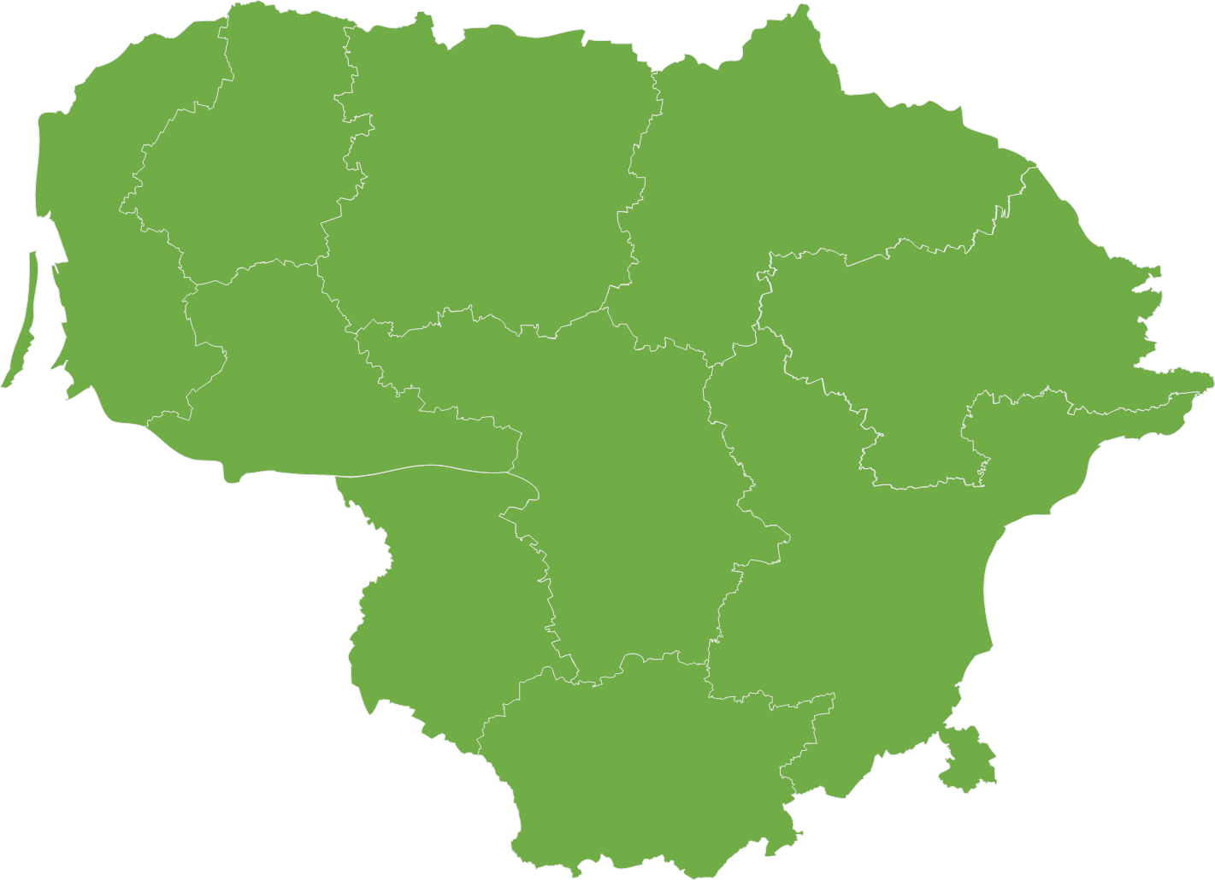
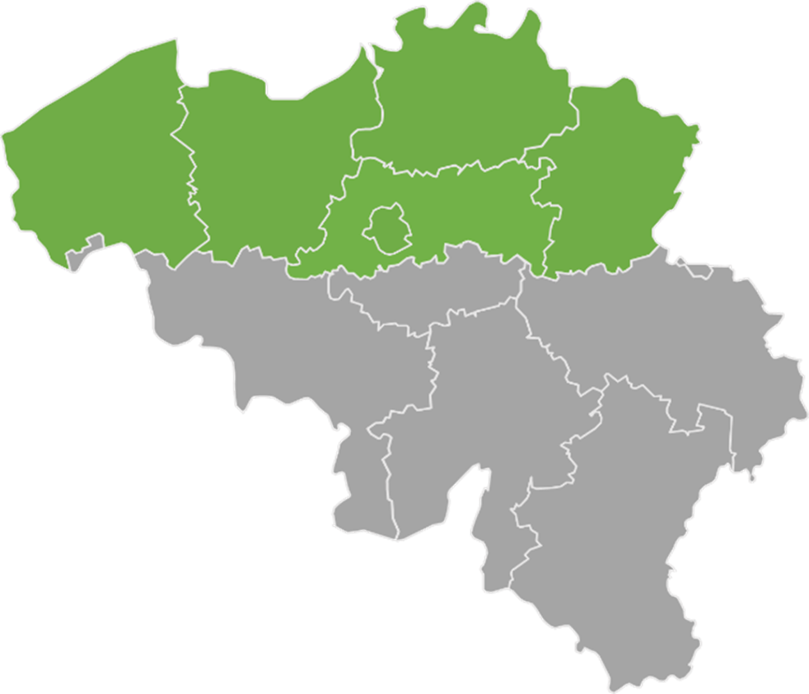

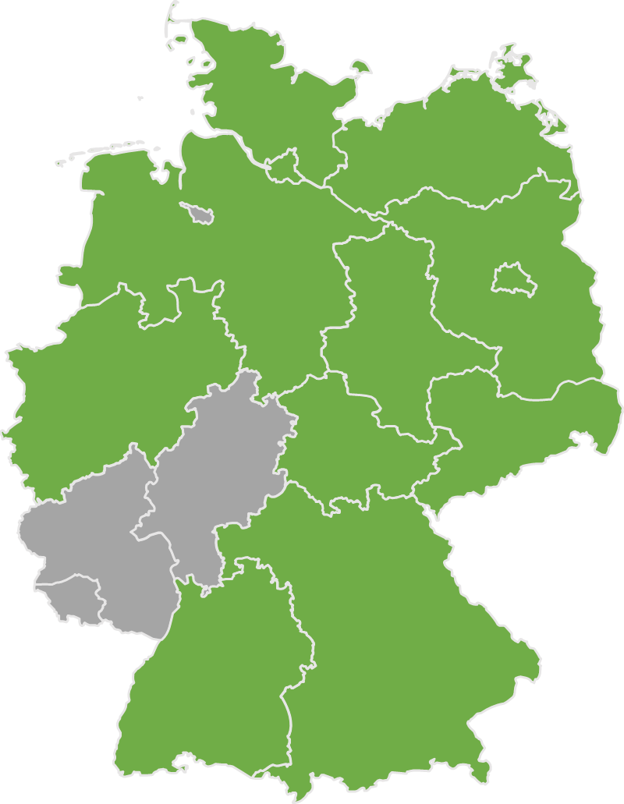
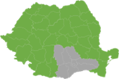
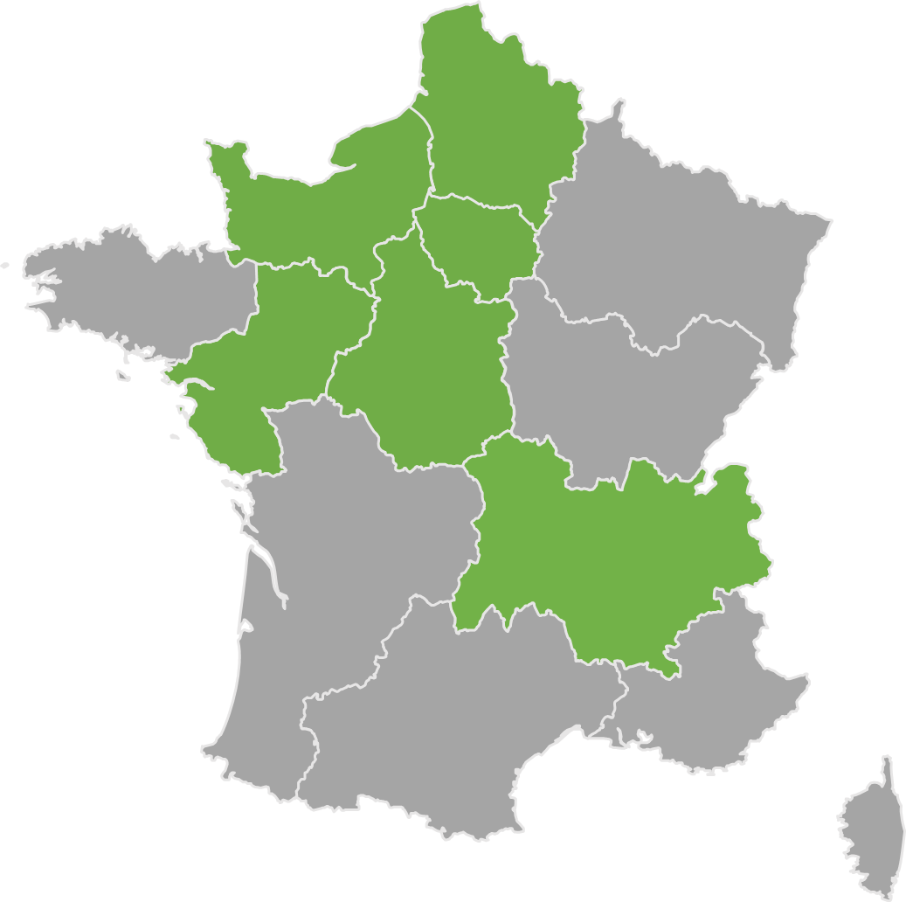
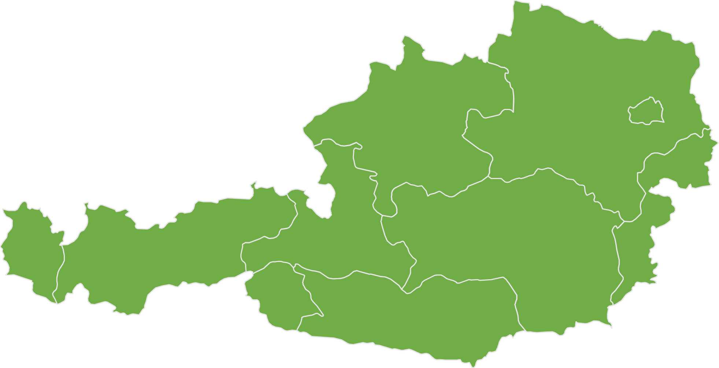
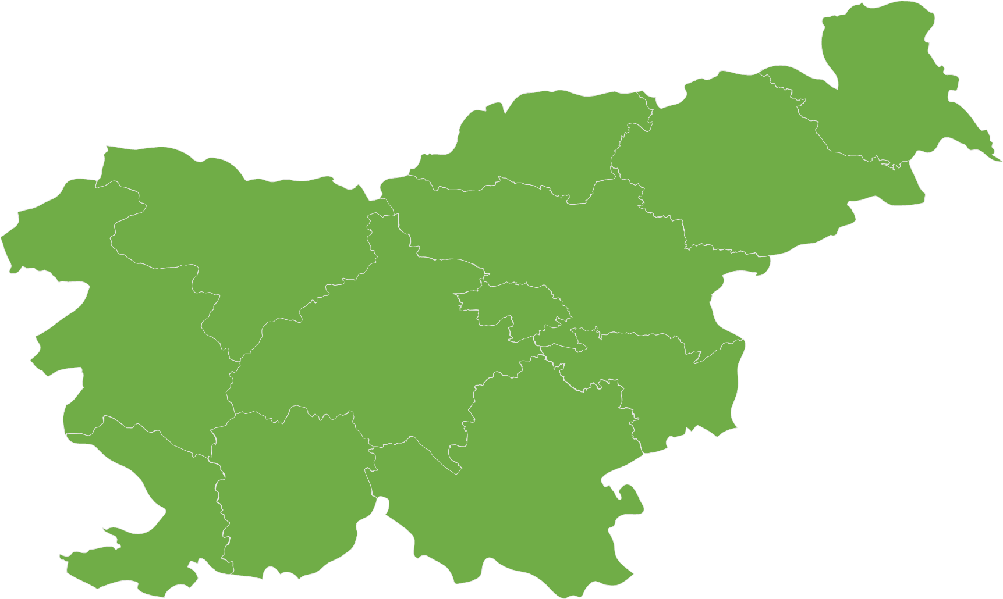
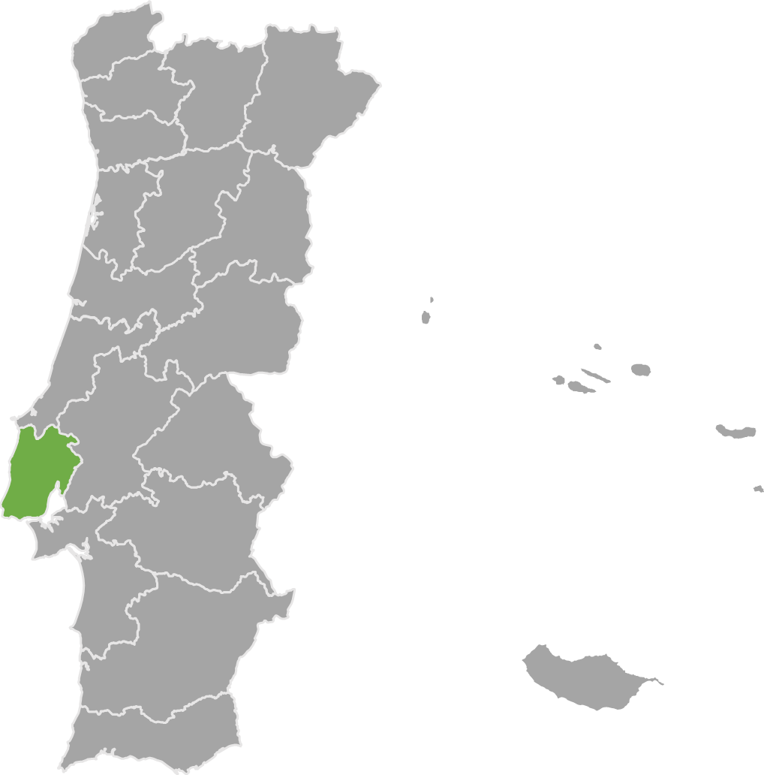
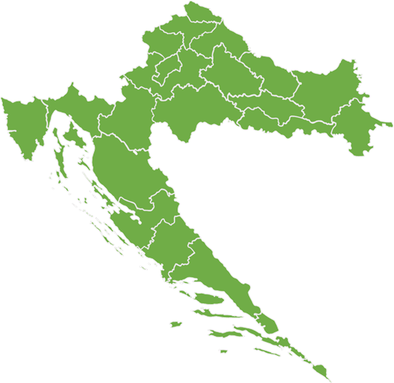
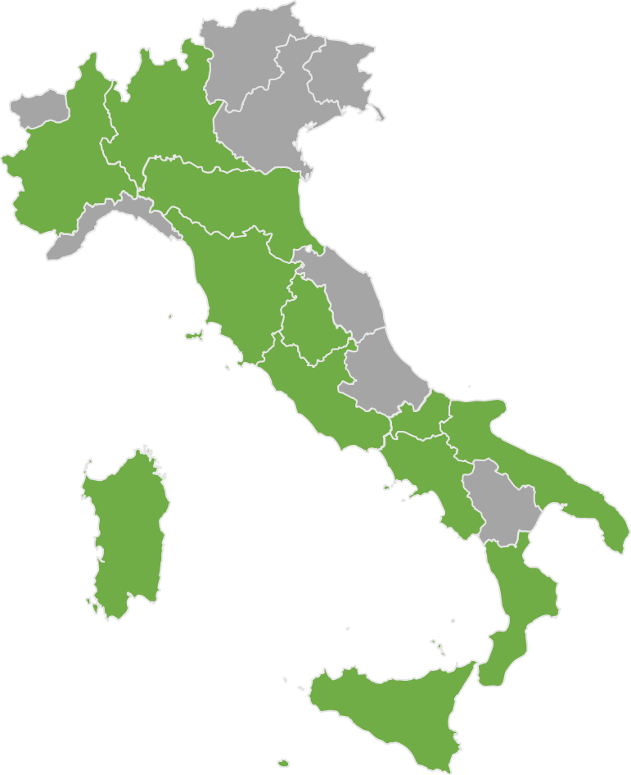
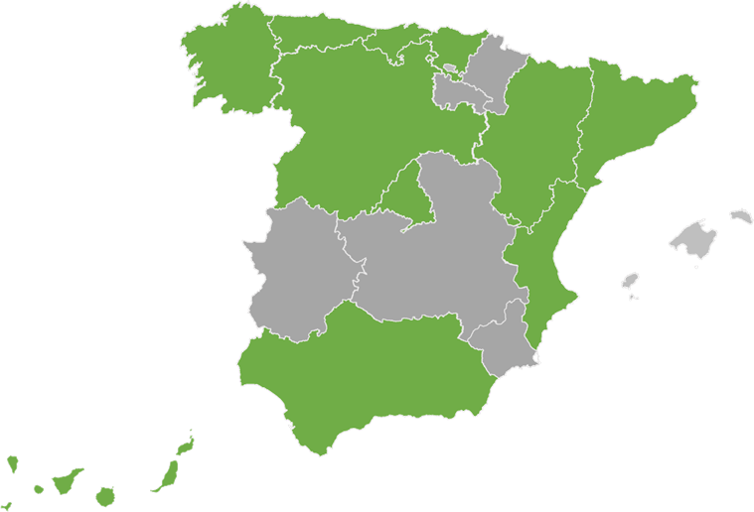
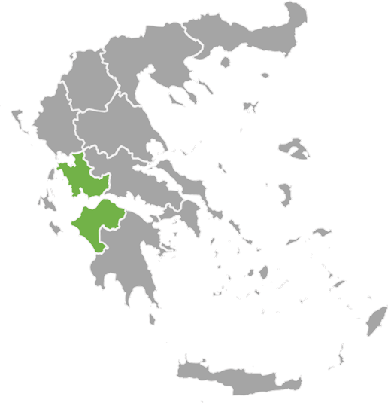
STEP (last update 05/09/2025)
Poland – EUR 956m
1 national and 2 regional ERDF programmes
Denmark – EUR 52m
Adopted programmes
1 national JTF programme
Latvia – EUR 57m
Netherlands – EUR 20m
1 national ERDF programme
1 regional ERDF and 1 national JTF* programme
Lithuania – EUR 59m
1 national ERDF programme
Belgium – EUR 69m
Slovakia – EUR 232m
2 regional ERDF programme
1 national ERDF programme
Germany – EUR 1.3 bn
Romania – EUR 1.7bn
12 regional ERDF, 1 regional JTF and
1 regional ESF+ programmes
1 national ESF+,
2 national and 6 regional ERDF and 1 national JTF programmes
France – EUR 154m
Austria – EUR 18m
1 national JTF programme*
6 multifund programmes
Slovenia – EUR 103m
Portugal – EUR 1.3 bn
1 national ERDF programme
1 national and 1 regional ERDF programme
Croatia – EUR 48m
1 national ERDF programme
Spain – EUR 921m
Italy – EUR 4.1bn
Greece – EUR 284m
1 national JTF, 10 regional and 1 national ERDF, 3 regional ESF+ programmes
1 National and 12 Regional ERDF, 2 National ESF+ programmes
2 national ERDF/ESF+, 1 National JTF and 1 regional ERDF programme
Notes:
6 MS, 33 programme amendments for ERDF, JTF and ESF+
Clean tech, digital tech, biotech and skills covered.
2nd wave + it can happen after too

Slide 3
Reprogramming - Germany
1 Regional ESF+, 1 Regional JTF and 11 Regional ERDF Programmes (EUR 1.3 billion):
Other programmes under assessment by the European Commission
Examples of actions: Support to SMEs, large enterprises (in the JTF regions), vocational training and research institutions in the fields of critical digital technologies, biotechnologies, circular economy, deep-tech innovation, green and resource-efficient technologies, technology transfer activities between universities, research organisations and SMEs.
JTF | North Rhine Westphalia | EUR 418 m
ERDF | North Rhine Westphalia | EUR 259 m
 | Baden-Württemberg | EUR 62 m
 | Mecklenburg-Vorpommern | EUR 139 m
 | Bavaria | EUR 105 m
 | Hamburg | EUR 7.2 m
 | Berlin | EUR 10.4 m
 | Thuringia | EUR 20.7 m
 | Brandenburg | EUR 128 m
 | Niedersachsen | EUR 140 m
 | Sachsen-Anhalt | EUR 88 m
 | Saxony | EUR 14.6 m
 | Schleswig-Holstein | EUR 43 m
ESF+ | Bavaria | EUR 37 m

Slide 4


Reprogramming - Spain
1 national JTF, 1 national and 10 regional ERDF, 3 regional ESF+ programmes (EUR 921 million):
Examples of actions: advanced facilities to enhance photonic chips, quantum computing, public-private R&D&I partnerships involving SMEs and large enterprise, support for advanced projects labelled the Horizon Europe Seal of Excellence, artificial intelligence, semiconductors and clean technologies.
JTF | National programme | EUR 103.9
ERDF | C. Valenciana | EUR 144 m
 | Canarias | EUR 21 m
 | Catalonia | EUR 114 m
 | Comunidad de Madrid | EUR 73 m
 | Castille Leon | EUR 45 m
 | Aragon | EUR 23 m
 | Cantabria | EUR 16 m
 | Basque Country | EUR 33 m
 | Andalucía | EUR 244 m
 | Asturias | EUR 15 m
 | Plurirregional programme* | EUR 9 m
ESF+ | Comunidad de Madrid | EUR 64 m
 | Galicia | EUR 23 m
 | Cantabria | EUR 3 m
*new programme version submitted, under assessment by the EC

Slide 5
Reprogramming - Italy
1 National ERDF, 2 National ESF+ and 12 Regional ERDF Programmes (EUR 4.1 billion):
Other programmes under assessment by the European Commission
Examples of actions: pharmaceuticals, aerospace, and cloud computing, tissue and cell engineering, green hydrogen, onshore and offshore wind energy, mechanics and mechatronics, quantum computing.
ERDF | National Research and Innovation | EUR 601 m
 | Lombardy | EUR 120 m
 | Emilia Romagna | EUR 61 m
 | Tuscany | EUR 98 m
 | Umbria | EUR 31 m
 | Lazio | EUR 109 m
 | Campania | EUR 581 m
 | Apulia | EUR 471 m
 | Calabria | EUR 264 m
 | Molise | EUR 45 m
 | Piemonte | EUR 100 m
 | Sicily | EUR 615 m
 | Sardinia | EUR 166 m
ESF+ | Youth, Women and Jobs | EUR 200 m
 | School and Skills | EUR 646 m

Slide 6
Reprogramming - France
6 multifund programmes (ESF+, ERDF and JTF) (EUR 154 million):
  Other programmes under assessment by the European Commission
  Examples of actions: support to skills for the development and/or production activities of STEP technologies, financial instruments for industrial startups and innovative SMEs (deep tech innovation, digital, clean and resource-efficient technologies)
ERDF, ESF+ and JTF | Île de France | EUR 47 m
 | Auvergne-Rhone-Alpes | EUR 10 m
 | Pays de la Loire | EUR 6 m
 | Normandie | EUR 26 m
 | Hauts de France | EUR 52.9 m
 | Centre-Val de Loire | EUR 12 m

Slide 7
Reprogramming - Denmark
1 National JTF Programme (EUR 52 million): North and South Jutland
Examples of actions:
  including the related value chains,
  competence and skills development in the enterprises.
  Carbon Capture Utilisation and Storage
JTF | North and South Jutland | EUR 52 m

Slide 8
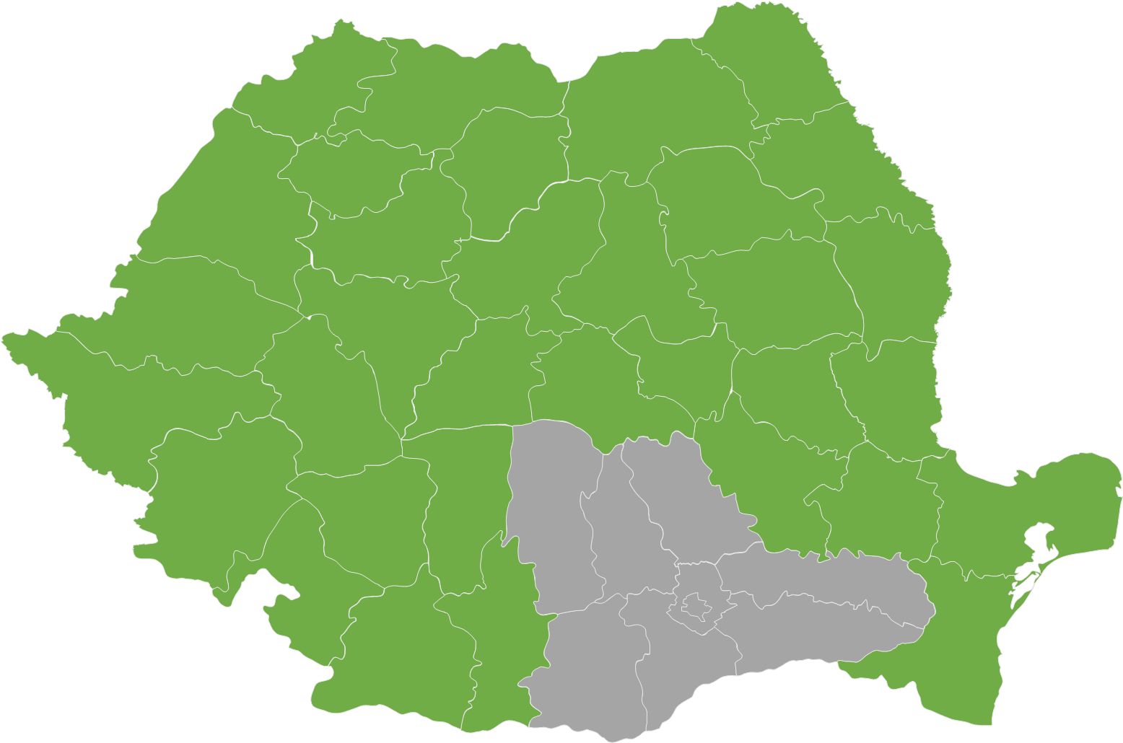
Reprogramming - Romania
2 National and 6 Regional ERDF, 1 JTF and 1 ESF+ National programmes (EUR 1.7 billion):
Other programmes under assessment by the European Commission
Examples of actions: public research projects on AI, hydrogen, and semiconductors, biotech, AI, and robotics in healthcare, training healthcare professionals, investments in STEP technologies by SMEs and industrial installations.
JTF | National | EUR 266 m
ERDF | Smart Growth | EUR 271 m
 | Health | EUR 466 m
 | South-West Oltenia | EUR 10 m
 | North East | EUR 6 m
 | South East | EUR 10 m
 | Central region | EUR 10 m
 | West | EUR 20 m
 | North-West | EUR 10 m
ESF+ | Employment and Education | EUR 573 m

Slide 9
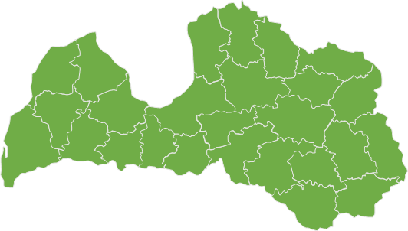
Reprogramming – Latvia
1 National ERDF Programme (EUR 56 million):
Examples of actions: Development of a high-capacity port and logistics infrastructure to attract RES (wind energy technology) component manufacturing companies in Latvia and support programmes for the development of critical marine wind technologies:
ERDF | National | EUR 56 m

Slide 10
Reprogramming – Lithuania
1 National ERDF Programme (EUR 59 million)
Examples of actions: acquisition and development of technologies, developing high-value-added industries, technologies in the field of defence and security, including special features and special machinery, provide cumulative or alternative funding to projects with a STEP Seal.
ERDF | National | EUR 59 m

Slide 11
Reprogramming – The Netherlands
1 regional ERDF and one national JTF programme* (EUR 20 mill)
Examples of actions: Experimental developments on renewable energy, Innovation pathways in SMEs, smart energy systems or battery technologies and energy storage technologies, experimental gardens and livinglabs, demonstrations of new applications and solutions
ERDF | East Netherlands | EUR 16 m
JTF | National programme | EUR 4 m

Slide 12
Reprogramming – Poland
1 national and 2 regional ERDF Programmes (EUR 956 million):
Examples of actions: biotechnologies, focusing on research to develop new treatments using gene therapy for the treatment of Parkinson disease, support to Polish companies in the implementation of projects characterized by a high level of innovation in digital technologies.
ERDF | Mazowsze | EUR 35 m
ERDF | Dolny Śląsk | EUR 20 m
ERDF | Smart Economy | EUR 901 m

Slide 13
Reprogramming – Austria
1 National JTF Programme* (EUR 18 mill)
Examples of actions: digital technologies and deep tech innovations, clean and resource-efficient technologies and biotechnologies, skills to diversify into green business and accompanying companies in transition
JTF | National programme | EUR 18 m
*new programme version submitted, under assessment by the EC

Slide 14
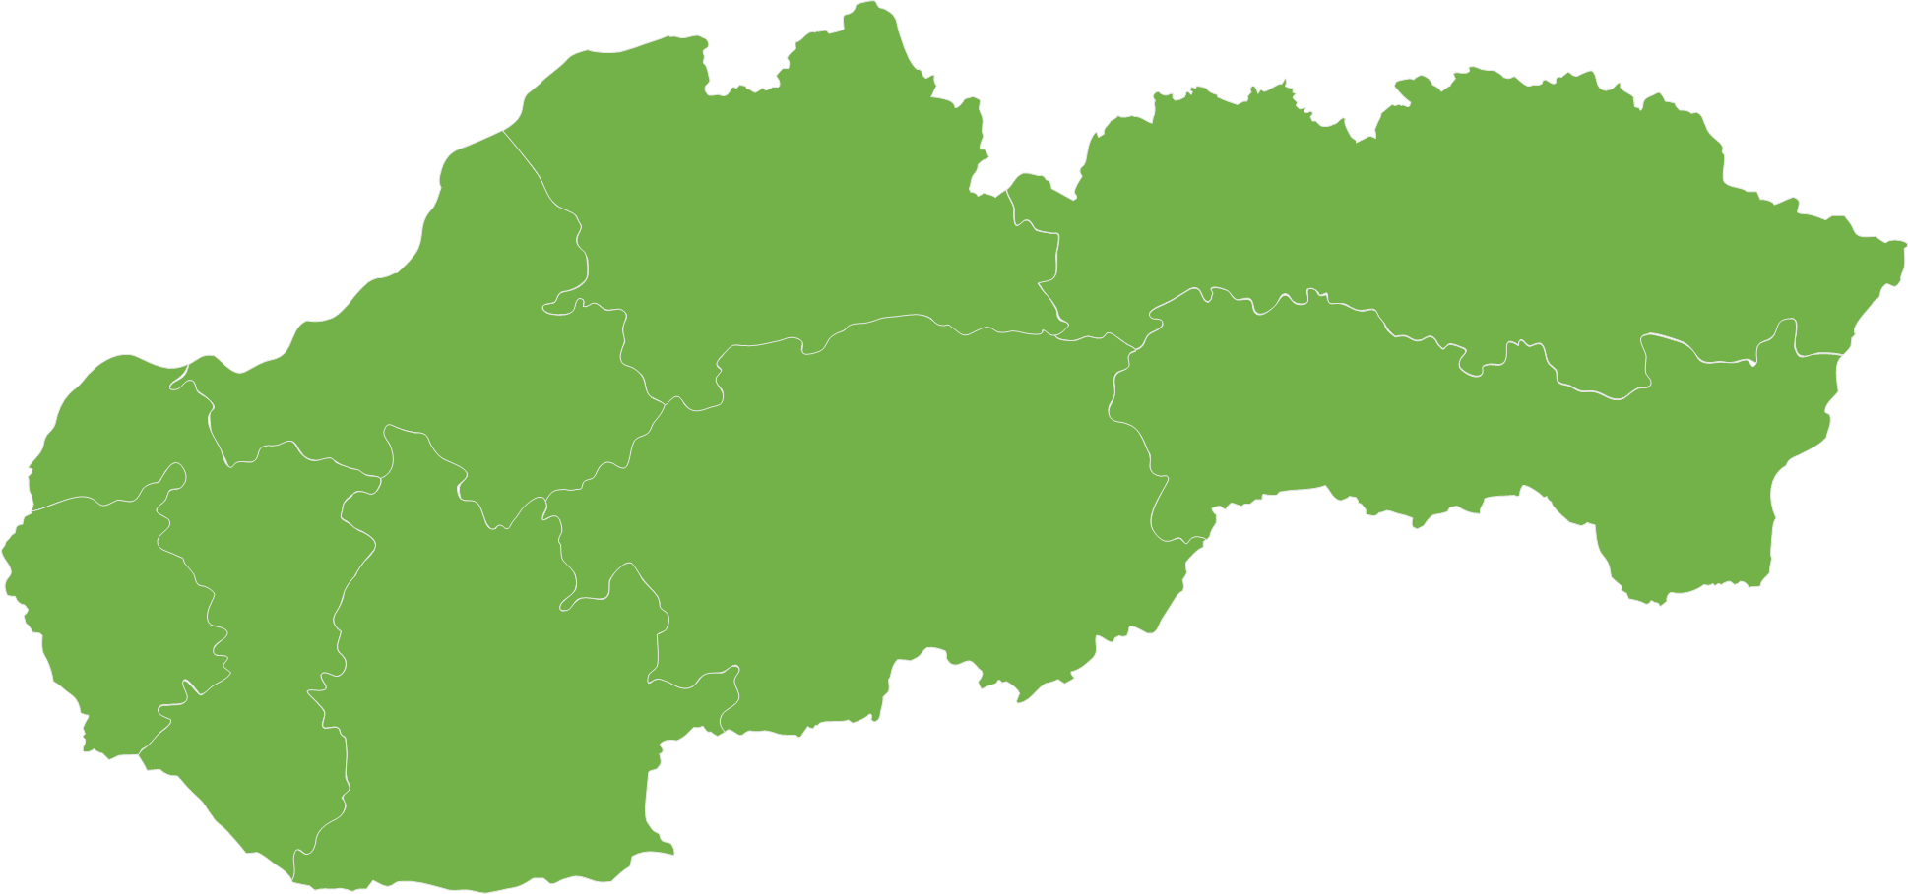
Reprogramming – Slovakia
1 National ERDF Programme (EUR 232 mill)
Examples of actions: productive investments, and industrial research in the areas of digital technologies, cybersecurity technologies, robotics technologies, artificial intelligence technologies, energy technologies, eco-innovation technologies, biotechnologies and semiconductor technologies
ERDF | National programme | EUR 232 m

Slide 15

Reprogramming – Belgium
1 Regional ERDF Programme (EUR 69 mill)
Examples of actions: technological advances in biotechnology, clean and resource-efficient technologies, and digital technologies, and the development of critical skills.
ERDF | Brussels Region | EUR 18 m
 | Flanders | EUR 52 m

Slide 16
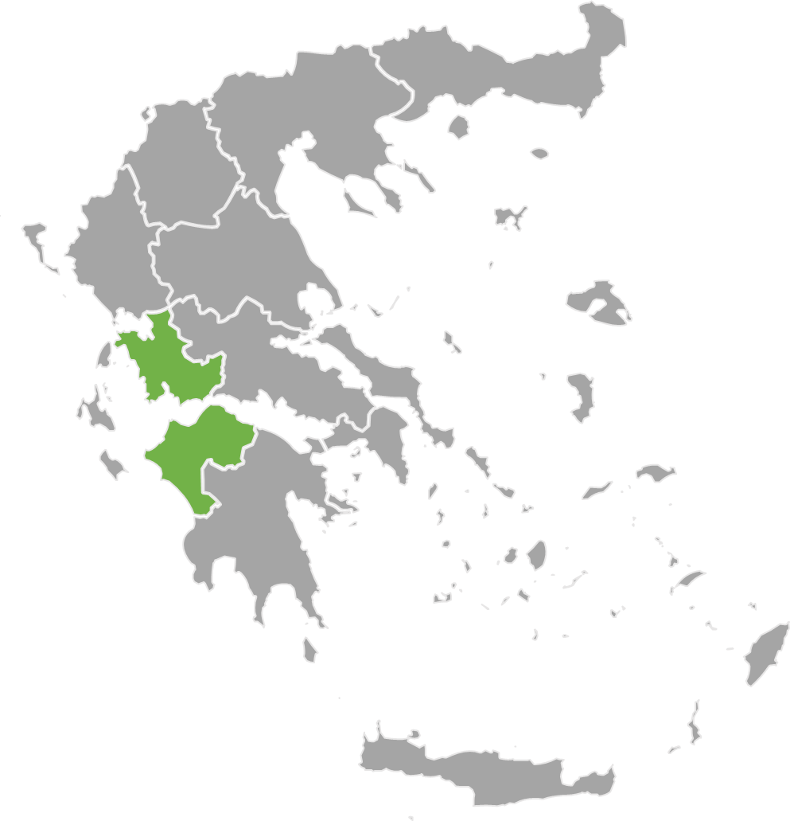
Reprogramming – Greece
2 National ERDF/ESF+ and JTF, and 1 Regional ERDF Programme (EUR 284 mill)
Examples of actions: development, retraining, and upgrading of digital skills relevant for the development/manufacturing of critical technologies
ERDF/ESF+ | Digital transformation | EUR 57 m
ERDF | Dytiki Ellada | EUR 8.5 m
 | Competitiveness | EUR 150 m
JTF | Just Development transition | EUR 69 m

Slide 17
Reprogramming – Portugal
1 National ERDF and 1 Regional ERDF Programme (EUR 1.3 bn)
Examples of actions: Supports business investments in R&I and production for clean, resource-efficient, and zero-impact technologies, focused on decarbonisation, energy efficiency, and renewable energy, aligned with the RIS3 strategy.
ERDF | Innovation and Digital Transition Thematic Programme | EUR 1.3 bn
 | Lisbon | EUR 20 m

Slide 18
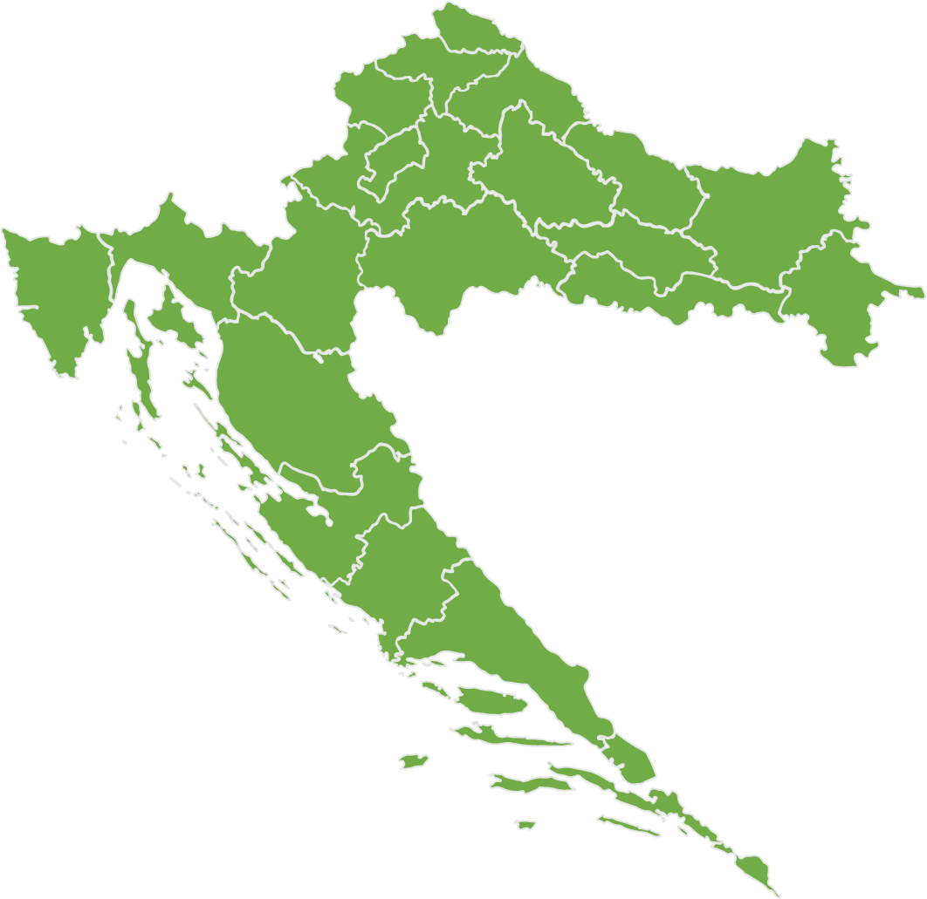
Reprogramming – Croatia
1 National ERDF programme (EUR 48 mill)
Examples of actions: development of critical and emerging technologies relevant for the green and digital transitions, from computing technologies, including microelectronics, quantum computing and artificial intelligence, to biotechnology and biomanufacturing and net-zero technologies.
ERDF | National programme | EUR 48 m

Slide 19
Reprogramming – Slovenia
1 National ERDF Programme (EUR 103 mill)
Examples of actions: research and innovation projects (TRL 4–9) with the aim of transitioning to commercial production and projects aimed at establishing production, support for projects with the sovereignty seal (STEP seal), and support to projects in the areas of biotechnology (field of pharmaceuticals and related disciplines) and digital technologies (particularly in the field of chips and semiconductors).
ERDF | National programme | EUR 103 m

